Slide 1
Leadership in Managing Natural Resources for Ecosystem Services and Resilience: The Case of Estero Bay, Florida
Shirley Baker, Professor
University of Florida
Notes:
Suggested Citation
Baker, S. (2022). Leadership in managing natural resources for ecosystem services and resilience: The case of Estero Bay. Global Education Lab. https://www.globaleducationlab.org/portfolio/baker2
This material is based upon work that is supported by the National Institute of Food and Agriculture, U.S. Department of Agriculture, under award number 2019-70003-29092. Any opinions, findings, conclusions, or recommendations expressed in this publication are those of the author(s) and do not necessarily reflect the view of the U.S. Department of Agriculture.

Slide 2
Learning Objectives
Upon completion of this case study students will be able to:
Describe the roles of parks/preserves and defend their conservation.
Describe and compare management strategies to improve resilience and resistance of natural resources to natural disasters and climate change.
Critique natural resource management plans and related disaster plans.
Describe leadership frames, evaluate the contributions of leadership frames in natural resource management, and consider how to apply leadership frames in their own careers.

Slide 3
Case Study Overview
Week 1
Leadership frames
Parks and managing for resilience and resistance
Estero Bay and Aquatic Preserve management plan
Week 2
Hurricane Irma and Estero Bay
Synthesis

Slide 4
LEADERSHIP FRAMES

Slide 5
Leadership Frames
Bolman and Deal (2013) Leadership Frames
Structural
Division of labor, policies, hierarchies
Human Resources
Individual needs, skills, limitations
Political
Power structures, networks
Symbolic
Vision, mission, values, culture
Notes:
One way to analyze a given leadership situation is through Bolman and Deal’s (2013) four leadership frames. The structural frame focuses on the organizational structure. It considers if the current structure is best for the environment in which the organization operates. This includes the roles and responsibilities of individuals in the organization. The human resources frame focuses on the individuals in the organization. It considers if people are working in the best positions and if they have the necessary knowledge and skills to accomplish what they are being asked to do. The political frame focuses on the relationships within the organization and connections between the organization and other organizations/institutions. It considers how information is exchanged and networks are built. The symbolic frame focuses on the culture of the organization. It includes things like the history, vision, and mission of the organization.

Slide 6
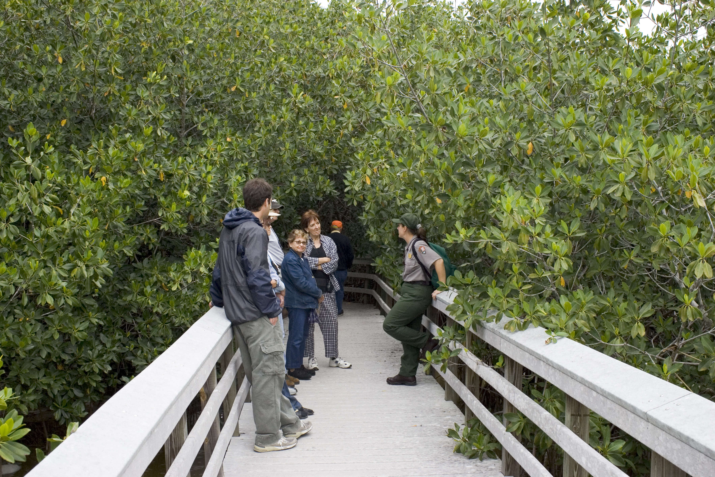
Discussion Question
What leadership frames might be important in managing natural resources?

Slide 7
Homework
Read:
Sowcik, M., H. Carter, and V. McKee. 2017. Reframing leadership. UF/IFAS Extension, AE622.
https://edis.ifas.ufl.edu/wc284
Notes:
One way to analyze a given leadership situation is through Bolman and Deal’s (2013) four leadership frames. The structural frame focuses on the organizational structure. It considers if the current structure is best for the environment in which the organization operates. This includes the roles and responsibilities of individuals in the organization. The human resources frame focuses on the individuals in the organization. It considers if people are working in the best positions and if they have the necessary knowledge and skills to accomplish what they are being asked to do. The political frame focuses on the relationships within the organization and connections between the organization and other organizations/institutions. It considers how information is exchanged and networks are built. The symbolic frame focuses on the culture of the organization. It includes things like the history, vision, and mission of the organization.

Slide 8
THE ROLES OF PARKS AND PRESERVES

Slide 9
Parks and Preserves
Conservation of land, water, and natural resources
Provision of ecosystem services

Slide 10
Provision of Ecosystem Services
Provisioning
Food
Fresh water
Fuel
Fiber
Regulating
Climate regulation
Carbon sequestration
Flood control
Water purification
Cultural
Spiritual
Recreation
Education
Aesthetic
Supporting
Soil formation
Primary production
Nutrient cycling
Notes:
One way to analyze a given leadership situation is through Bolman and Deal’s (2013) four leadership frames. The structural frame focuses on the organizational structure. It considers if the current structure is best for the environment in which the organization operates. This includes the roles and responsibilities of individuals in the organization. The human resources frame focuses on the individuals in the organization. It considers if people are working in the best positions and if they have the necessary knowledge and skills to accomplish what they are being asked to do. The political frame focuses on the relationships within the organization and connections between the organization and other organizations/institutions. It considers how information is exchanged and networks are built. The symbolic frame focuses on the culture of the organization. It includes things like the history, vision, and mission of the organization.

Slide 11
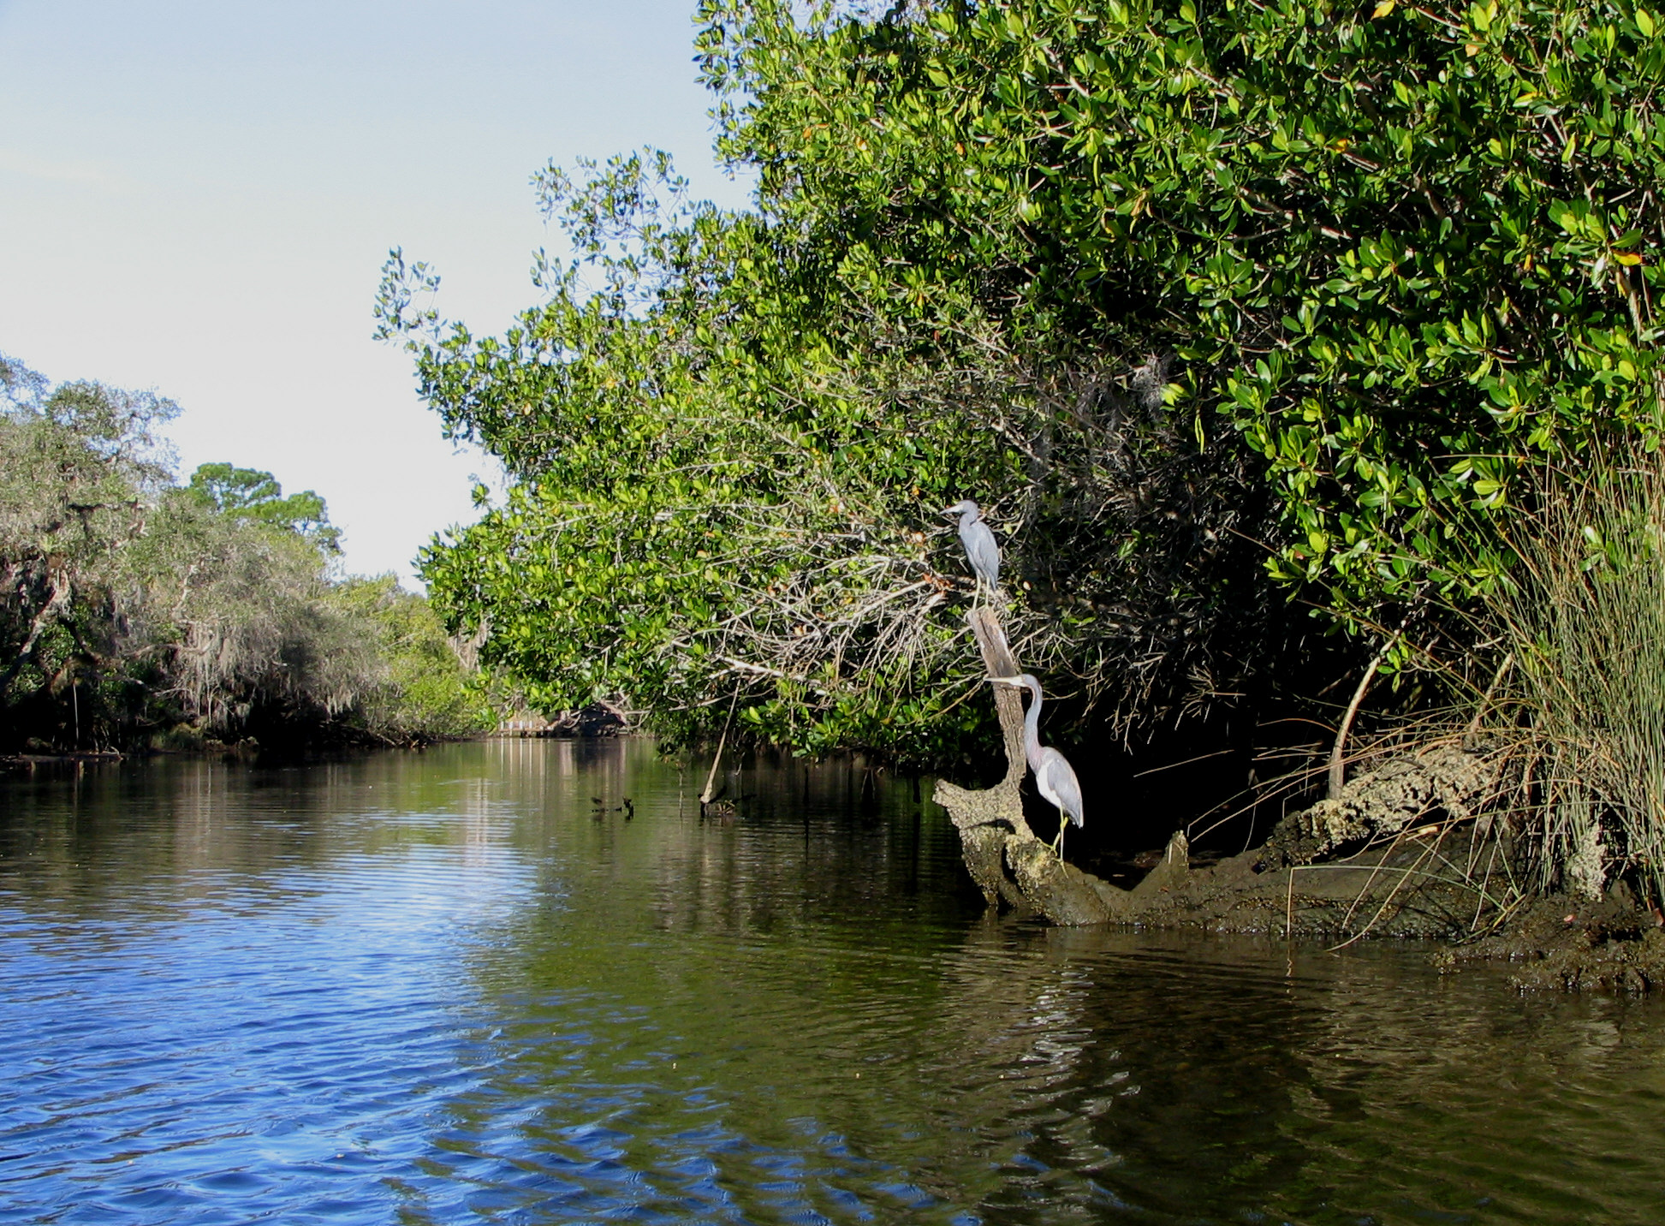
Discussion Question
What ecosystem services do parks and preserves provide?

Slide 12
Homework
Read:
Dudley, N., L. Higgins-Zogib, M. Hockings, K. MacKinnon, T. Sandwith, and S. Stolton. 2011. National parks with benefits: How protecting the planet’s biodiversity also provides ecosystem services. Solutions for a Sustainable and Desirable Future 2 (6): 87-95.
https://www.thesolutionsjournal.com/article/national-parks-with-benefits-how-protecting-the-planets-biodiversity-also-provides-ecosystem-services/

Slide 13
MANAGEMENT STRATEGIES FOR RESILIENCE AND RESISTANCE

Slide 14
Resilience and Resistance
Disturbance
Disturbance
Resilience
Resistance
Ecosystem Function
Time

Slide 15
Managing for Resilience and Resistance

Slide 16
Discussion Question
What management practices might increase resilience and resistance to perturbations such as climate change and natural disasters?

Slide 17
Homework
Read:
West, J.M., S.H. Julius, P. Kareiva, C. Enquist, J.J. Lawler, B. Petersen, A.E. Johnson, and M.R. Shaw. 2009. U.S. natural resources and climate change: Concepts and approaches for management adaptation. Environmental Management 44: 1001-1021.
Munang, R., I. Thiaw, K. Alverson, J. Liu, and Z. Han. 2013. The role of ecosystem services in climate change adaptation and disaster risk reduction. Current Opinion in Environmental Sustainability 5: 47-52.

Slide 18
INTRODUCTION TO THE ESTERO BAY COMPLEX

Slide 19
Estero Bay Aquatic Preserve
Established 1966, as Florida’s first aquatic preserve
11,000 acres of seagrass meadows, mangroves, rookery islands, oyster beds
Bordered by state parks
Administered by Florida Department of Environmental Protection (DEP), Florida Coastal Office

Slide 20
Discussion Questions
What stakeholders may have an interest in the management of the Estero Bay Aquatic Preserve?
What leadership frames may be involved in stakeholder relationships?

Slide 21
Homework
Explore:
Estero Bay Aquatic Preserve https://floridadep.gov/rcp/aquatic-preserve/locations/estero-bay-aquatic-preserve
Estero Bay Preserve State Park https://www.floridastateparks.org/parks-and-trails/estero-bay-preserve-state-park
Koreshan State Park https://www.floridastateparks.org/parks-and-trails/koreshan-state-park

Slide 22
Further Discussion Questions
What ecosystem services does the Estero Bay Complex provide?
How does the Estero Bay Complex mitigate climate change and natural disasters?
How does each leadership frame (structural, human resource, political, symbolic) contribute to the successful function of parks and preserves in general? Of the Estero Bay Complex, in particular?

Slide 23
ESTERO BAY AQUATIC PRESERVE MANAGEMENT PLAN

Slide 24
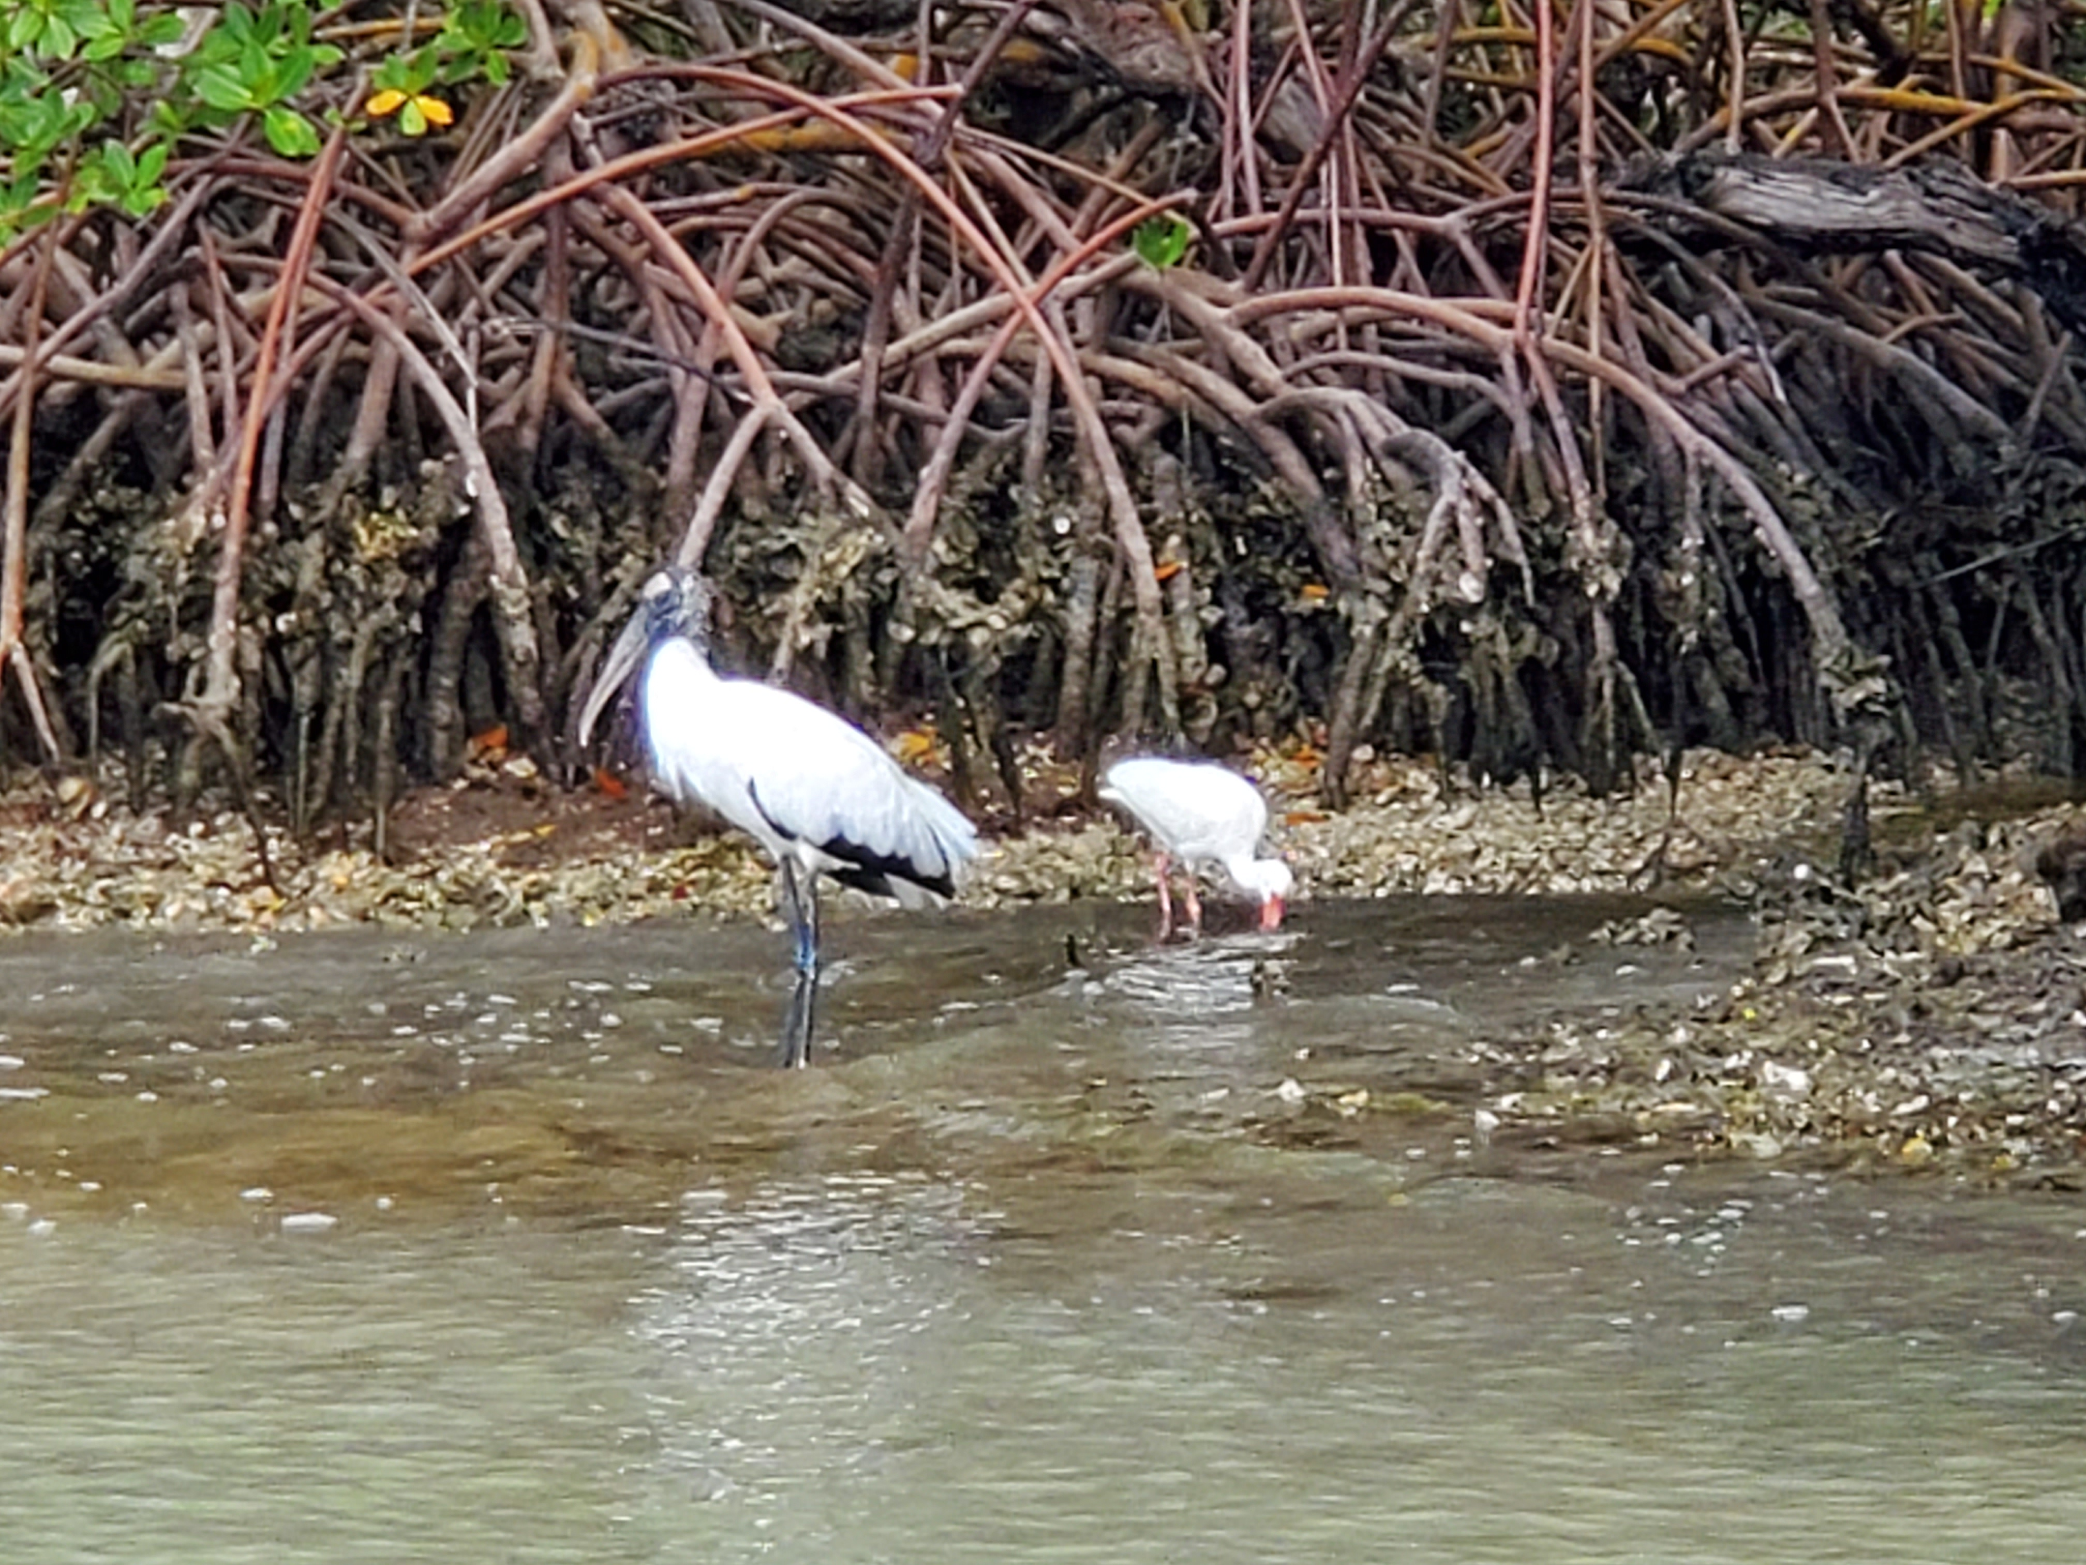
Estero Bay Management Plan
Goals:
Protect and enhance ecological integrity
Restore areas to natural condition
Encourage sustainable use and stewardship
Issue-based management:
Water quality
Coastal and watershed development
Submerged resources
Nesting birds
Public use

Slide 25
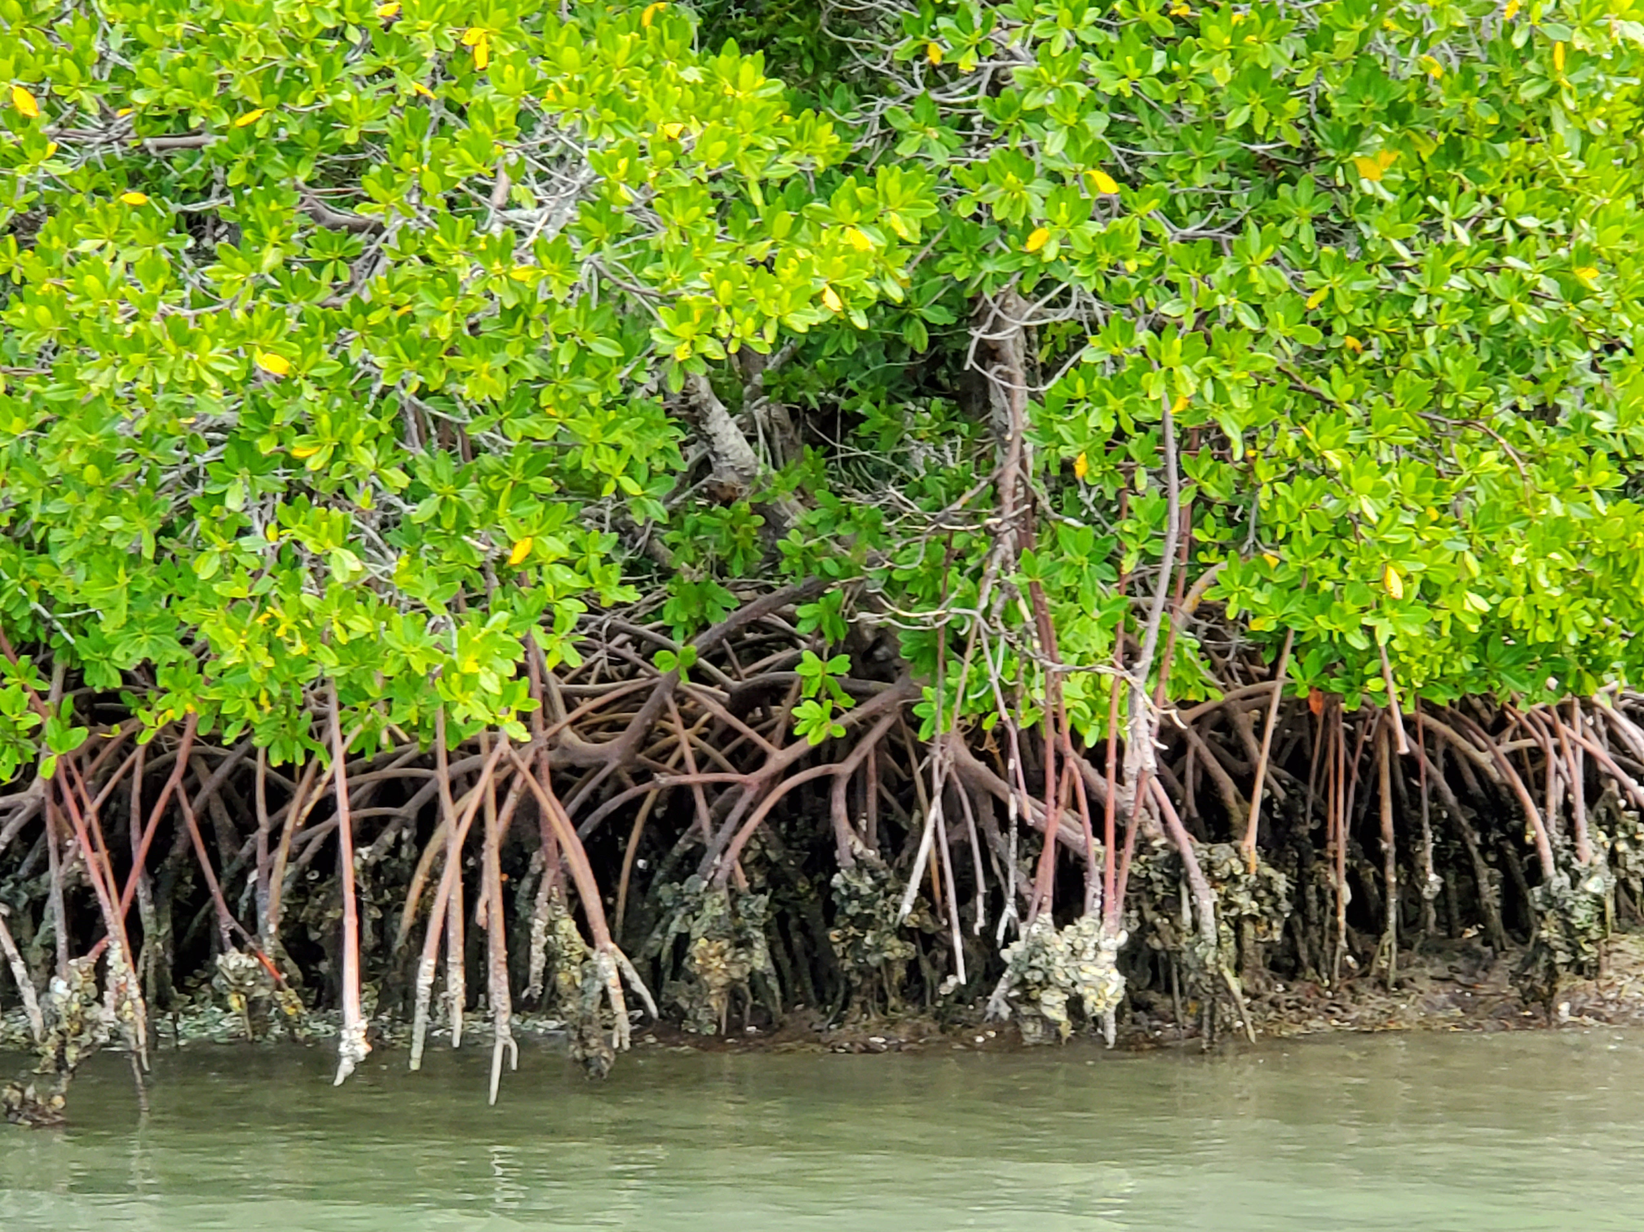
Estero Bay Management Plan
Considers climate change
Rising temperatures
Sea level rise
Hurricane intensity
Mangroves are of particular importance
Nursery and nesting habitat
Sediment stabilization and nutrient cycling
Upland protection

Slide 26
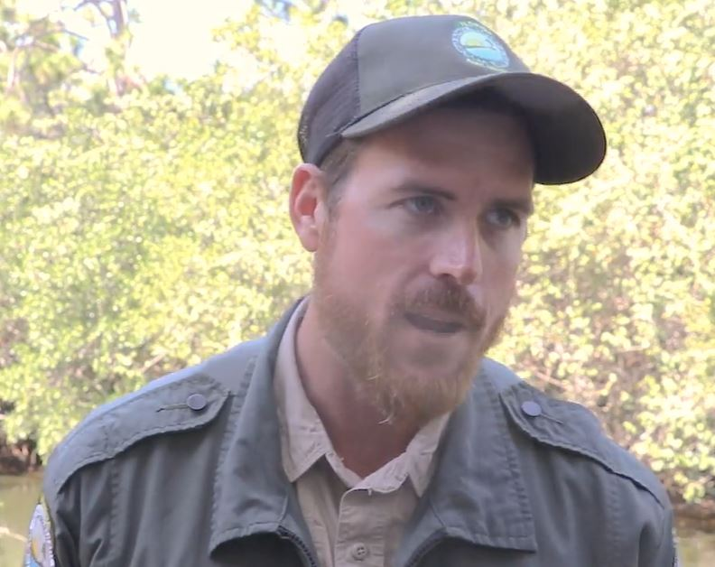
Interview with Justin Lamb
Environmental Specialist with the Florida Park Service
Watch:
[Estero Bay Management Objectives]
[Role of Mangroves and Pines in Park Resilience]

Slide 27
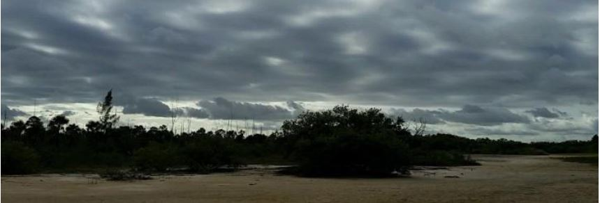
Discussion Question
What management strategies are currently being employed in the Estero Bay Complex that contribute to resistance and resilience to climate change?
How do mangroves and pines contribute to the climate resistance and resilience to the Complex and surrounding areas?

Slide 28
Homework
See also:
Florida Department of Environmental Protection. 2015. Estero Bay Aquatic Preserve Management Plan. 218 pp. https://floridadep.gov/rcp/aquatic-preserve/locations/estero-bay-aquatic-preserve

Slide 29
Further Discussion Questions
Who manages natural resources, in general? Who makes decisions concerning management of the Estero Bay Complex?
What management strategies are currently being employed in the Estero Bay Complex that contribute to resistance and resilience to climate change? To disturbance, such as hurricanes?
What other management strategies could be implemented to improve the resistance and resilience of the Estero Bay Complex?
What barriers might be encountered in implementing different/new management strategies?
How do leadership frames (structural, human resource, political, symbolic) contribute to management barriers? Alternatively, how might each leadership frame contribute to opportunities in shifting management strategies?

Slide 30
HURRICANE IRMA

Slide 31
Hurricane Irma in South Florida
Landfall 40 miles south of Estero Bay, September 10, Category 3
Sustained winds of 112 mph, 20” of rain
5’ storm tide
6+ million people under evacuation orders

Slide 32
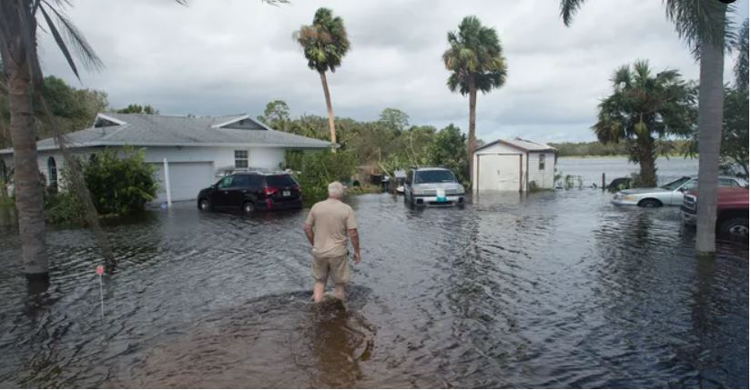
Discussion Question
What social, economic, and ecological impacts did Hurricane Irma have on South Florida?
TCPalm.

Slide 33
Homework
Explore:
The National Weather Service, Hurricane Irma Local Report/Summary https://www.weather.gov/mfl/hurricaneirma
Cangialosi, J.P., A.S. Latto, and R. Berg. 2018. Hurricane Irma. National Hurricane Center Tropical Cyclone Report. AL 112017. 111 pp. https://www.nhc.noaa.gov/data/tcr/AL112017_Irma.pdf
See also:
NOAA National Weather Service, Miami-South Florida National Weather Service Forecast Office. 2019. 2019 Florida Severe Weather Awareness Week https://www.weather.gov/media/mfl/news/HurcnWeb_2019.pdf

Slide 34
ESTERO BAY AND HURRICANE IRMA

Slide 35
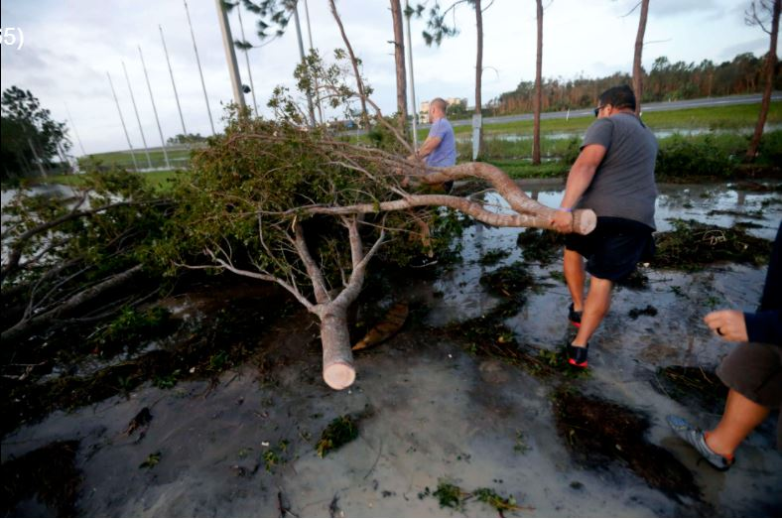
Storm Response at Estero Bay
Preserve’s Protection Plan includes “major hurricane”
Specific instructions for storm preparation and aftermath
“Hurricane Strike Teams” of state park staff deployed
wtop news

Slide 36
Interview with Justin Lamb
Environmental Specialist with the Florida Park Service
Watch:
[Planning for Natural Disasters]

Slide 37
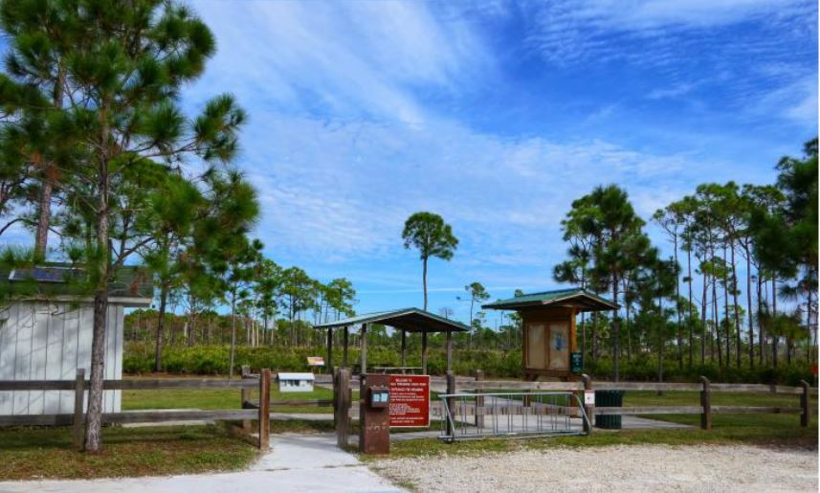
Discussion Question
Were both the natural and human resources of the Estero Bay Complex well-prepared for Hurricane Irma?
TCPalm.

Slide 38
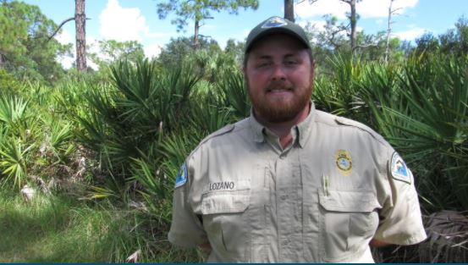
Homework
See also:
“Manager’s Message” and “People Make the Park, ” Estero Bay Preserve State Park https://www.floridastateparks.org/parks-and-trails/estero-bay-preserve-state-park
Zach Lozano is the Park Manager at Estero Bay Preserve State Park

Slide 39
Further Discussion Questions
Was Estero Bay well-prepared for a natural disaster/disturbance event such as Hurricane Irma? Consider the natural and human resources associated with the Complex.
How did the natural resources of Estero Bay Complex successfully/unsuccessfully contribute to mitigating this disturbance event?
How did each leadership frame (structural, human resource, political, symbolic) contribute to the Complex’s success or failure in mitigating the impacts of Hurricane Irma?
In addition to hurricanes, what other acute or chronic disturbance events might impact the natural resources and ecosystem services of the Estero Bay Complex?
How might each leadership frame contribute to improving the management of the Estero Bay Complex to better respond to future hurricanes or other disturbance events?

Slide 40
Synthesis Questions
Effective leadership is essential for successful natural resource management, at all levels, from technician to administrator.
How has this exercise shaped your ideas about the role of parks/preserves and their natural resources in the provision of ecosystem services and in mitigating climate change and natural disasters?
How has this exercise shaped your ideas about disaster planning in natural resource management?
How has this exercise shaped your ideas about leadership, in general? Leadership in your organization?
Moving forward, how might you apply what you’ve learned about leadership frames to your own organization or career?

Slide 41
Preparing Organizational Leaders in Agriculture through Innovative Leadership Case Studies Contextualized in Agricultural Disasters
This material was created with funding from:
USDA/NIFA Higher Education Challenge Grant
Project # 2019-70003-29092
University of Florida, Auburn University, Texas A&M University, The University of Tennessee
Contact:
Dr. Grady Roberts
Professor
Agricultural Education and Communication
University of Florida
PO Box 112060
Gainesville, FL 32611-2060
groberts@ufl.edu
globaleducationlab.org

