Slide 1
HURRICANE MICHAEL FOLLOWED BY COVID:
A case study on the aftermath of two tragic events at a high school in the Florida Panhandle
Rigo A. Chaparro & Carla Jagger
Notes:
Suggested Citation
Chaparro, R. A., & Jagger, C. (2022). Hurricane Michael followed by Covid: A case study on the aftermath of two tragic events at a high school in the Florida Panhandle. Global Education Lab. https://www.globaleducationlab.org/portfolio/chaparrojagger
This material is based upon work that is supported by the National Institute of Food and Agriculture, U.S. Department of Agriculture, under award number 2019-70003-29092. Any opinions, findings, conclusions, or recommendations expressed in this publication are those of the author(s) and do not necessarily reflect the view of the U.S. Department of Agriculture.

Slide 2
Background

Slide 3
Background Hurricane Michael
Hurricane Michael formed in the Gulf Coast on November 7th 2018.
It hit the Florida panhandle on October 10th at Mexico city Beach, Fl as a Cat-5 hurricane.
The storm hit Jackson County as a Cat-4 hurricane, with wind speeds up to 155 miles per hour.
Massive damage was done to timber and structures in the area.
Many homes were completely or partially destroyed from the storm

Slide 4
Background Hurricane Michael Con.
Cottondale High School is home to almost 500 students and is in Jackson County School District
There was no major damage structurally to the Cottondale High School.
Students were impacted by the school being closed for close to 3 weeks.
Many within Jackson County were without power and exposed to the Florida elements for nearly 3 weeks.
Stan Scurlock (gatekeeper) is the agriculture educator/FFA advisor.

Slide 5
Background Covid-19
Covid was discovered in multiple countries in January 2020.
Schools across America shut down and moved to online learning in March 2020.
Most in person events were cancelled or moved to a virtual setting (graduations, competitions, extra-curricular activities, sports).
Students, Teachers, and Administrators were unsure what to do and how to respond.

Slide 6
Overview/Analysis

Slide 7
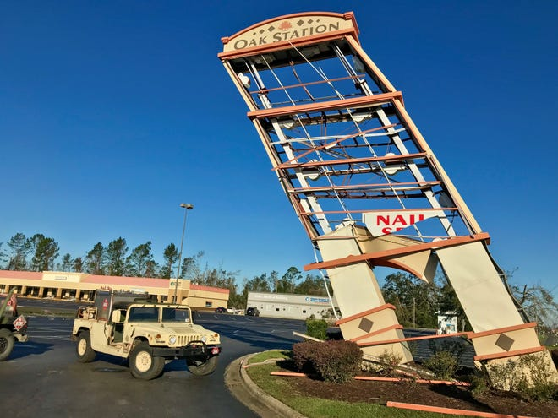
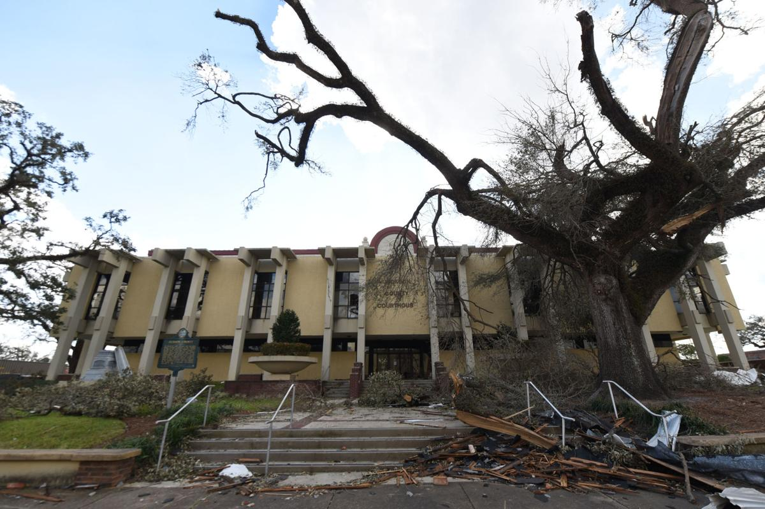
Hurricane damage to Jackson County

Slide 8
Impacts to the Ag. Program
Loss of motivation for schoolwork and graduation
Hard to keep students focused when some were living in chaos at home.
FFA program member numbers remained relatively the same.
Major impacts on natural resource supervised agricultural experiences such as forestry, and row crops
50-60 students left either prior to or after the storm and never returned.
Humanitarian aid from central Florida ag programs.

Slide 9
Covid and Cottondale High
Early January 2020 the Novel Corona Virus gains global attention.
Due to the COVID-19 pandemic Cottondale High School was shut down in early March.
Administrators initially anticipated returning to school after a few weeks.
All school programs bother inter and extra-curricular are cancelled.
School is moved permanently online during the spring 2020 semester.
All graduations are moved online.

Slide 10
Covid Impacts to Cottondale Ag. Program
Student motivation to graduate or participate in class plummeted
FFA membership dropped to half of its’ original number
Students and Stan had never experienced this type of catastrophe in their educational experience.
Compassion/Mercy are leading to the negative behaviors that teachers are facing in the classroom today.
Due to the challenge of meeting in person students lost the desire to compete in FFA events
“Students are losing faith in their educational system” Stan Scurlock.

Slide 11
Leadership Frames

Slide 12
Leadership Frames
This case study utilized Bolman & Deal’s (2013) leadership frames theory.
This theory gives a holistic view due to the four lens that must be consider when analyzing an organization, school, or scenario.
The lens that this theory utilize are: Structural, Human Resources, Symbolic, and Political.

Slide 13
Structural Frame
Processes currently found within an organization.
Current procedures, rules, goals, policies, and environment that exist or need to be reviewed are all included in the structural frame.
Another consideration is whether the current structure of an organization is the best for the current situation or if change is needed.

Slide 14
Structural Frame Questions
Prior to the hurricane, define the responsibilities of the teacher and the student in the classroom. How did those responsibilities change after Hurricane Michael? Were there additional changes in responsibilities after Covid 19?
What do you think of Stan’s feelings towards showing compassion towards students? What educational theories support your decision?
How did communication from the high school administration impact Stan’s ability to teach after the hurricane and during the pandemic? Structurally, were there alternatives that could be considered?

Slide 15
Human Resource Frame
Identifies the people in an organization, the needs of the individuals, and their value within the organization.
Looks at prejudices, dissatisfaction, diversity, and team building.
Assesses the human capital and if they can fulfill their roles within the organization, because of how their needs and values align with the organization’s goals.

Slide 16
Human Resource Frame Questions
Frustration and disappointment were common emotions felt through both catastrophic events. How did Stan and his students handle these emotions?
Stan fought against students who no longer had the desire to go to school. What are some options, other than those he tried, that could help his students build back trust in the educational system?
After Hurricane Michael, the school lost fifty to sixty students. How did this impact student and teacher morale?
If you were a leader in this community reflecting on Hurricane Michael and Covid, how would you try to prevent loss in the future?
What are some ways that Stan empowered his students?
If you were the teacher in this program, how would you try to empower your students?
How did CDE’s act as motivators for students?
How did Stan’s actions help his organization overcome the challenges they faced and lead the organization to success?

Slide 17
Symbolic Frame
Looks at the stories, myths, traditions, missions, and values within an organization.
Make up the culture within an organization.
Looks at how these elements are being addressed, respected, and evaluated.

Slide 18
Symbolic Frame Questions
Once competitions were cancelled for in person participation due to the hurricane and Covid continued to cancel in person activities, why do you think the program lost so many members?
How important was the FFA culture to the success of the program?
How do you think the stories and experiences students went through will change the culture of the Cottondale FFA program? Why or why not?
After these students have been through so many challenging events together do you think the program will become more inclusive or less inclusive? Explain your reasoning.
How did ceremonies and symbols established prior to the hurricane help the students and teachers deal with struggles the hurricane and covid created?
What cultural elements could be created to help in the event of another storm or pandemic?

Slide 19
Political Frame
Takes an analytical look at the power dynamics within an organization, stake holder relations, and the communication pathways within the organization.
Looks at available resources within an organization and their distribution.
Looks at the current networks that exist and their impact on power in an organization.

Slide 20
Political Frame Questions
What are some of the benefits and disadvantages of Stan giving up some of his power to allow students to lead the FFA portion of his program?
How does Stan’s approach to leadership influence conflict resolution within the program? What could Stan do to prepare his students for conflict resolution that might arise due to the tension and stress associated with these catastrophic events?
How would creating spaces for the students to communicate concerns impact the agriculture program? What would be some of the benefits or disadvantages?
Do you think Stan had realistic goals when he decided to re-engage with FFA activities, and CDE practices? If you were Stan, what goals would you create for yourself, your students, and your program? Identify short term and long-term goals.
Why do you think community involvement could be beneficial to the agriculture program, especially after catastrophic events? How do you think Stan’s new role as President Elect for the National Association of Agriculture Educators will impact the power dynamic within his program?

Slide 21
Case Study

Slide 22
Case Study Application
Attached to the case study students will be required to put together a 10–15-minute presentation in a group.
These questions are designed for pre-service agriculture teachers.
To build their presentation questions within each of the frames of leadership will guide the students in getting a better picture of what transpired.
After their presentation students will submit a 1-page essay answering real world application questions connected to Hurricanes and natural disasters.

Slide 23
Summary of Findings
“I would rather face a Category 5 Hurricane over Covid” Stan Scurlock
Through both catastrophe the Ag teacher led by personal example both by staying active in his national teacher association, and through his personal perseverance and grit.
Student participation has increased and is close to pre-covid numbers 1 year after the school shut down.
Students appeared to be more optimistic about future FFA events and school.

Slide 24
Additional Research
Due to the findings in this case study, there is potential for future research:
What methods did teachers use when trying to motivate students after the COVID-19 pandemic?
What influence does Career Development Events have on student motivation after catastrophic events?
How does teacher’s leadership impact students desire to participate and lead?

Slide 25
Questions?

Slide 26
References
Bolman, L. G., & Deal, T. E. (2013). Reframing organizations: Artistry, choice, and leadership. Wiley
Burlew, J. (2018, Jan. 27). “It’s’ been miserable:” Power still out for thousands in North Florida after Hurricane Michael. Tallahassee Democrat. https://www.tallahassee.com/story/news/2018/10/21/its-been-miserable-power-still-out-many-north-florida/1721470002/
Centers for Disease Control and Prevention (CDC). (Late 2019). CDC museum COVID-19 timeline. https://www.cdc.gov/museum/timeline/covid19.html
Jackson County Board of County Commissioners. (2019, September). Restore Renew Rebuild. Jackson County. https://jacksoncountyfl.gov/uploads/2020/07/restore-jackson_191003_framework_tagged2.pdf
Jackson County School Board. (May, 2020). High school diploma presentations [Press release]. (https://www.jcsb.org/apps/pages/index.jsp?uREC_ID=1565517&type=d&pREC_ID=1862091
Leigh, M. (2019). Hurricane Michael anniversary: A look back at a category 5 monster. AL.com. https://www.al.com/hurricane/2019/10/hurricane-michael-anniversary-a-look-back-at-a-category-5-monster.html

