Slide 1
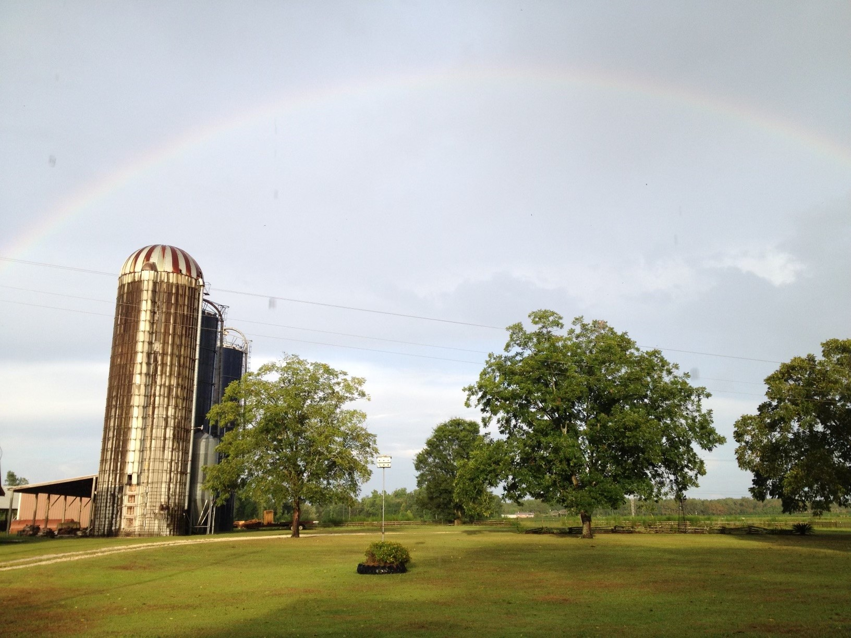
The Case of Crooked Creek Farms and Hurricane Michael in the Florida Panhandle
Heather Young, Graduate Student
Dr. J.C. Bunch, Professor
University of Florida
Notes:
The case of Crooked Creek Farms and Hurricane Michael in the Florida Panhandle.
By Heather Young, a Graduate Student at the University of Florida, and Dr. J.C. Bunch, a Professor at the University of Florida.
This case study is based on the real-life events at Crooked Creek Farms related to Hurricane Michael in 2018.

Slide 2
Learning Objectives
Upon completion of this case study students will be able to:
Describe issues related to managing a beef cattle operation during and after a natural disaster.
Discuss leadership issues related to managing a beef cattle operation after being impacted by a natural disaster.
Develop an emergency management plan for Crooked Creek Farms.
Identify examples of the resiliency of those within the agricultural industry whom a natural disaster has impacted.
Notes:
Upon completion of this case study, students will be able to:
Describe issues related to managing a beef cattle operation during and after a natural disaster.
Discuss leadership issues related to managing a beef cattle operation after being impacted by a natural disaster.
Develop an emergency management plan for Crooked Creek Farms.
Identify examples of the resiliency of those within the agricultural industry whom a natural disaster has impacted.

Slide 3
Case Study Overview
Day 1: Background information
Crook Creek Farm
Contractual grazing
Day 2: The challenge
Hurricane Michael
Leadership issues to consider
Defining the problem
Day 3: The solution
Notes:
This case study will be completed over three class sessions.
On the first day, we will look at the history of Crooked Creek Farms and learn about contractual grazing in the Florida Panhandle.
On the second day, we will learn about Crooked Creek Farms' challenges because of Hurricane Michael. We will also explore the leadership issues facing the owner and then define the problem to be solved.
On the third day, you will work with your group to develop a solution to present to the owner.

Slide 4
Background Information
Notes:
Let’s begin by learning about Crooked Creek Farms.
Crooked Creek Farms, owned and operated by Steve (Beaver) Yoder, is a stocker cattle and brood cow farm located in Altha, Florida, about 50 miles from Panama City.
Between 1995 and 2013, Beaver Yoder transitioned from dairy farming into operating 500 acres of row crops and 800 acres of grazing land for his 900 head of beef cattle.
More recently, he has switched to solely focusing on running cow/calf pairs, preconditioned, and stocker beef cattle on grazing land he contracts with other area farmers and ranchers.
Now we will hear about how contractual grazing in the Florida Panhandle works for Beaver.
He now purchases un-weaned and weaned calves and older cattle to precondition in the fall. Beaver grazes them on harvested row crops and re-seeded winter forage fields throughout the winter until mid-spring, when he will sell those cattle and purchase again in the summer.

Slide 5
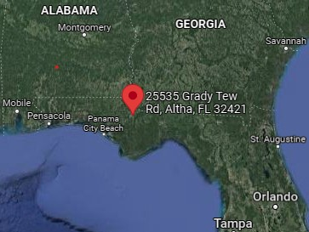
Crooked Creek Farms Location
25535 NE Grady Tew Road Altha, Florida
Calhoun County
Notes:
Crooked Creek Farms is in Altha, a small town in Calhoun County, near Panama City Beach in the Florida Panhandle.

Slide 6
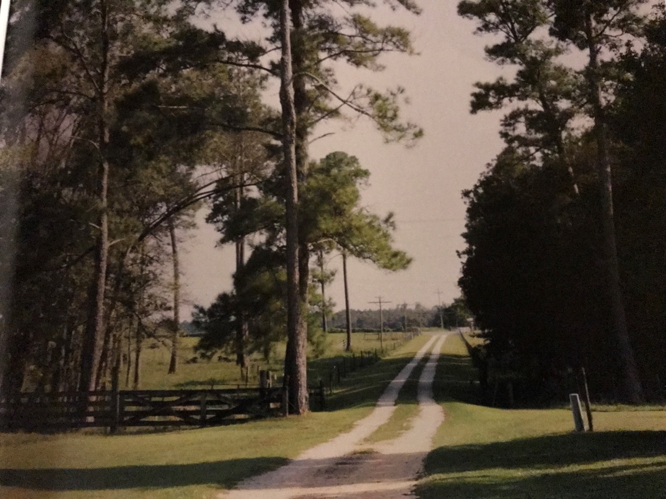
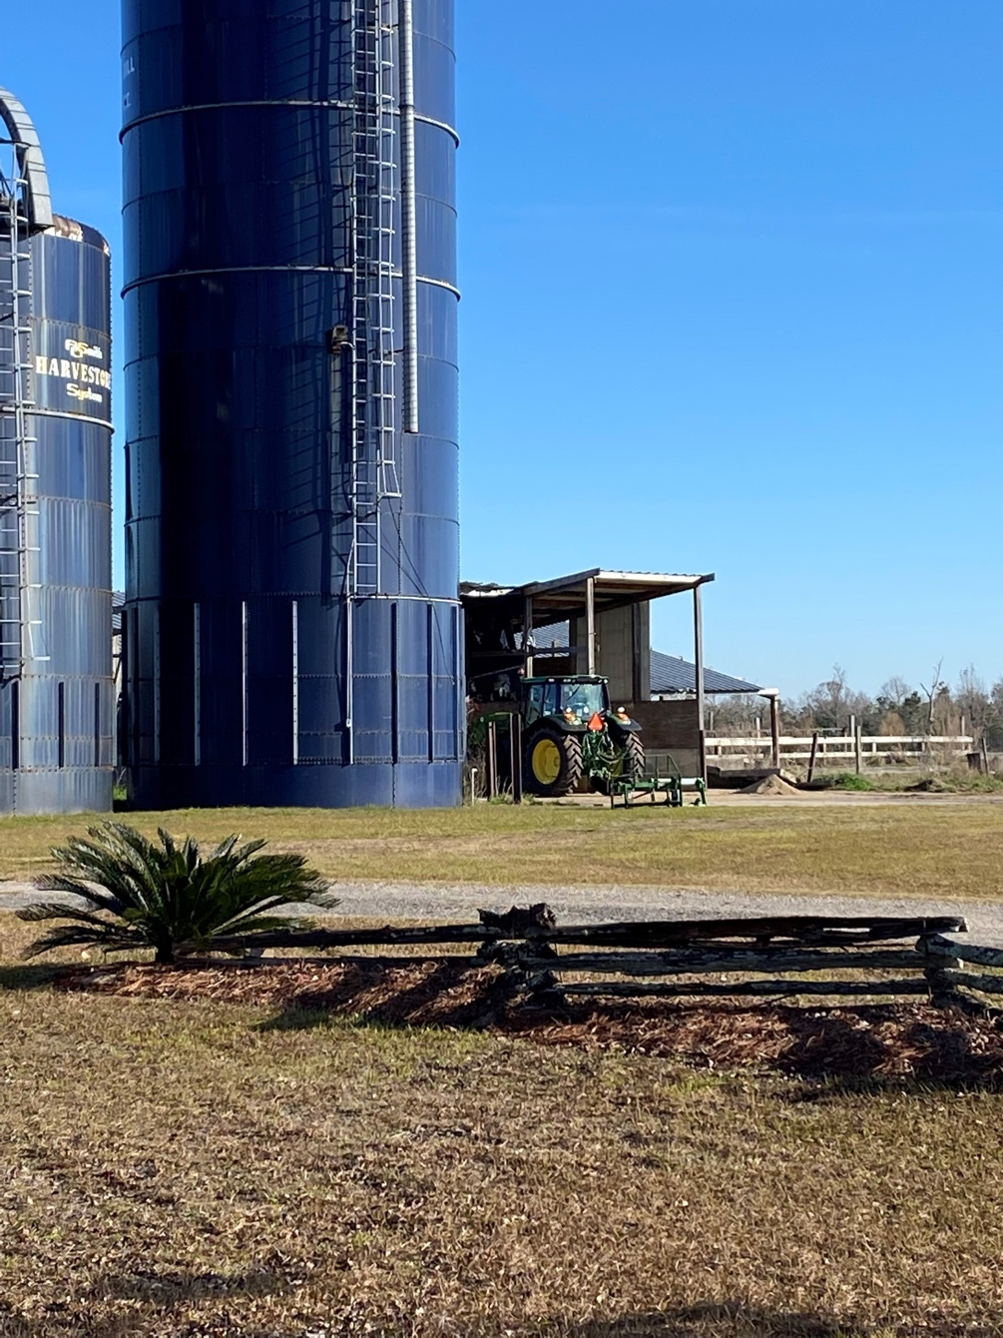
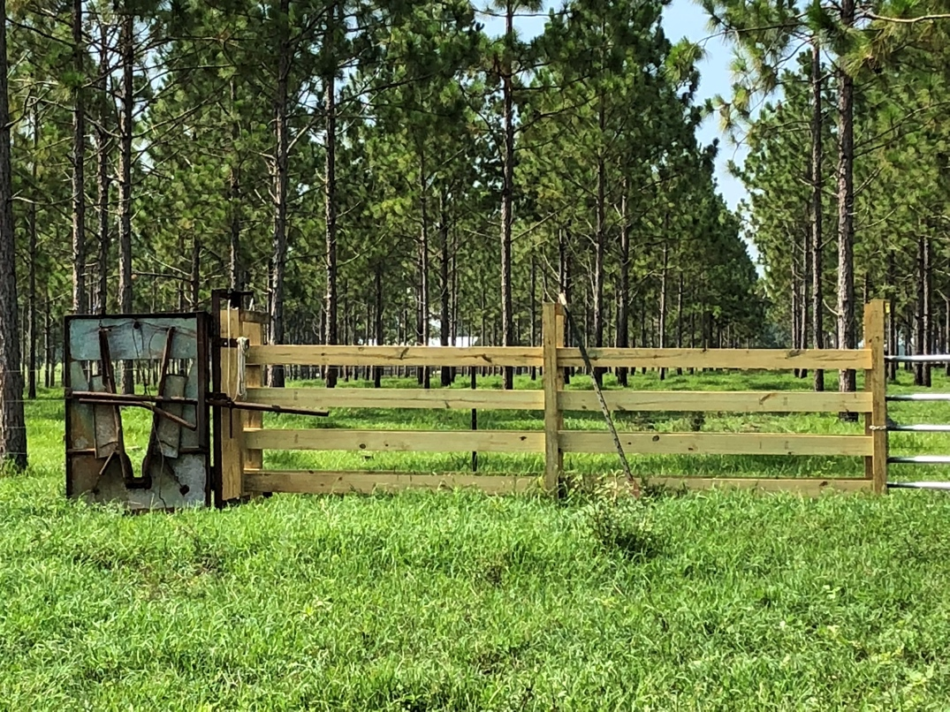
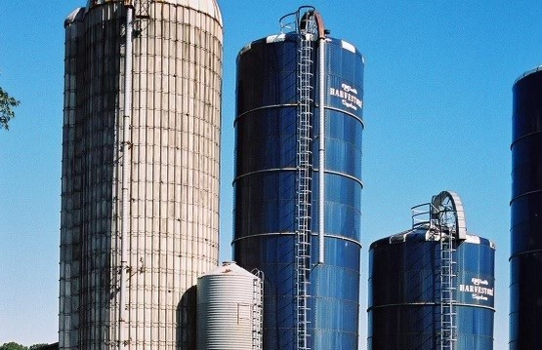
Pre-Hurricane Pictures
Notes:
Here are a few photos to show what Crook Creek Farms used to look like.

Slide 7
Discussion Question
What might be some challenges or benefits to grazing beef cattle in the Panhandle compared to other forms of livestock?
Notes:
What might be some challenges or benefits to grazing beef cattle in the Panhandle compared to other forms of livestock?

Slide 8
Homework
Describe how Crooked Creek Farms’ contractual grazing arrangements with row croppers works.
What are some advantages and disadvantages to this type of arrangement?
https://www.youtube.com/watch?v=s-JxMxGBHfU
Notes:
Your homework is to describe how Crooked Creek Farms’ contractual grazing arrangements with row croppers work.
You can listen to the entire video for additional information.

Slide 9
Damage and Destruction
Notes:
Let’s take a closer look at the damage and destruction Crook Creek Farms had to face.

Slide 10
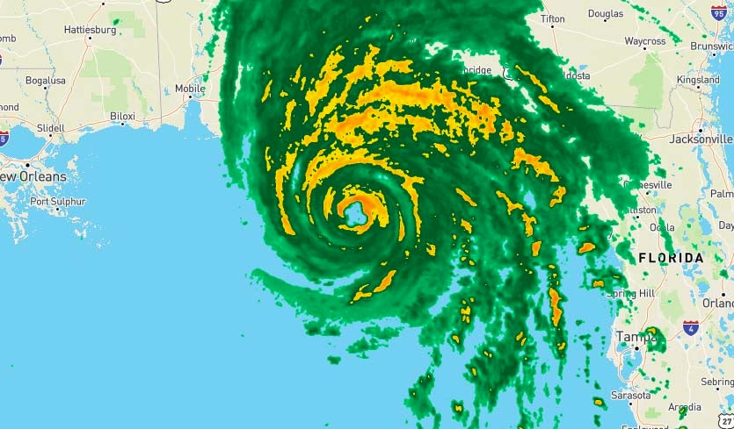
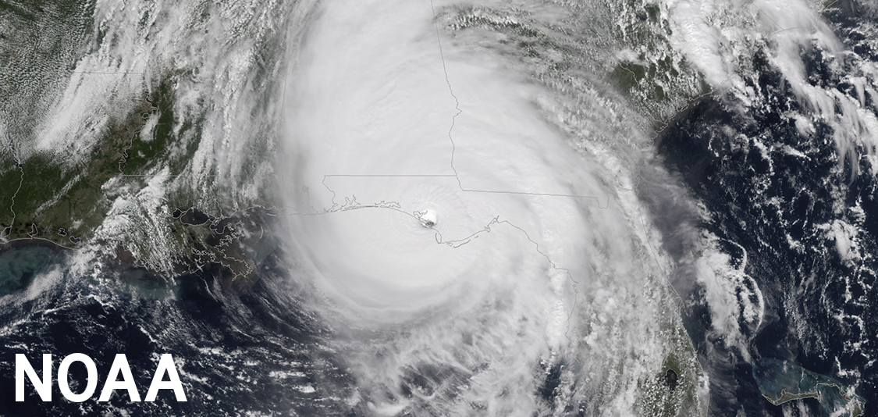
Hurricane Michael
Image source: https://www.nhc.noaa.gov/data/tcr/AL142018_Michael.pdf
Formed October 7, 2018
Made landfall October 10th
Category 5 Storm at landfall (160 mph winds)
9⎯14-foot storm surges on shorelines
Image source: https://www.wunderground.com/cat6/Potentially-Catastrophic-Hurricane-Michael-Nearing-Landfall-Florida-Panhandle
Panama City Beach to Altha
Notes:
Hurricane Michael formed October 7, 2018, and made landfall on October 10th. This storm intensified from a tropical storm rating to a category-1 hurricane in one day. Then in a matter of six hours, Michael’s winds intensified to 100 mph, increasing to a category-2 hurricane. This hurricane did not indicate it would be more than these residents could handle as it started to lull on October 8th. However, Michael was back up to a category-3 hurricane headed straight for Bay County by the following evening. By the time it made landfall on the 10th at 5:30 in the evening, the eye of the hurricane had passed directly over Panama City and the Panhandle, accompanied by 160 mph winds, 9–14-foot storm surges, significant damage to the shorelines, power outages, and $25 billion in damages. Calhoun County reported that close to 1,000 of their businesses (including schools) were damaged, and 30% of their residents reported home damages (Calhoun, 2020).
Hurricane Michael was still a Category 4 when it had reached the Alabama/Georgia state line and did not downgrade to a tropical storm until reaching the middle of Georgia.

Slide 11
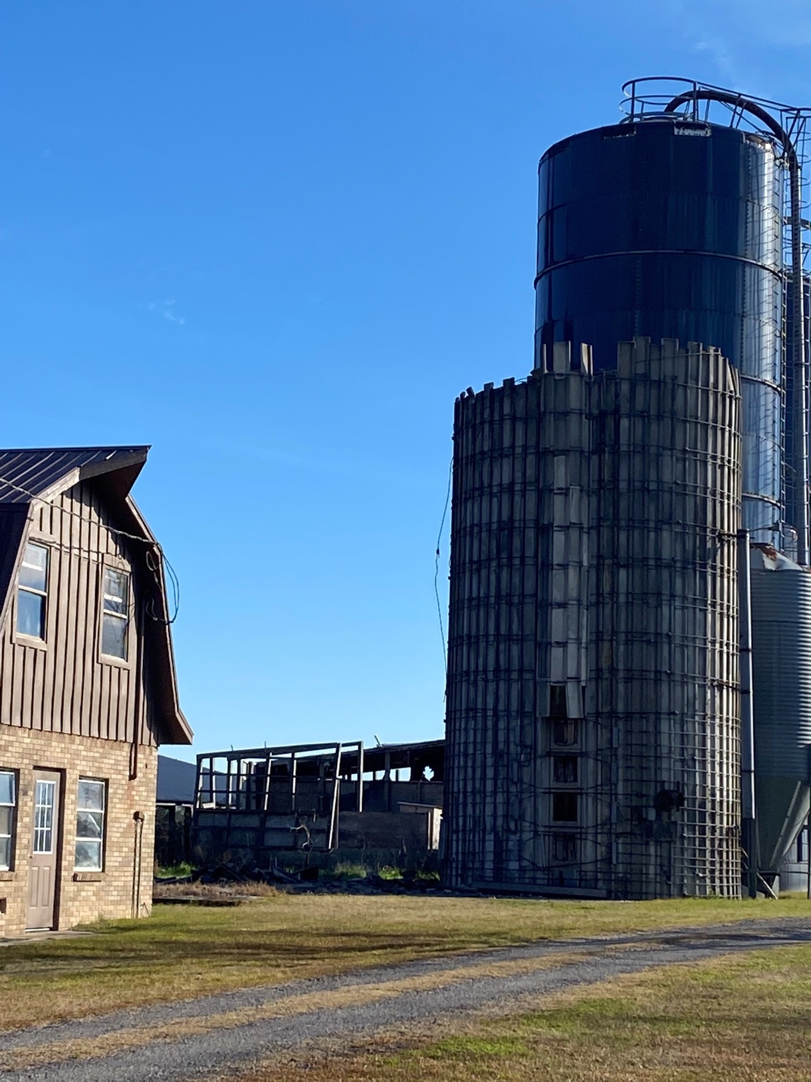
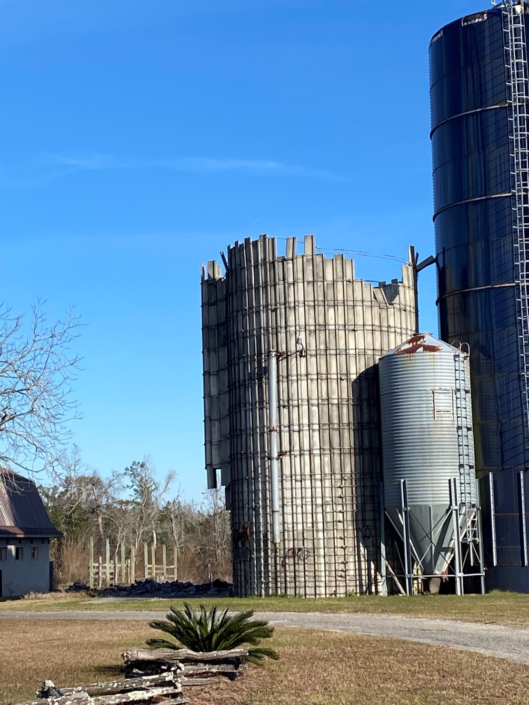
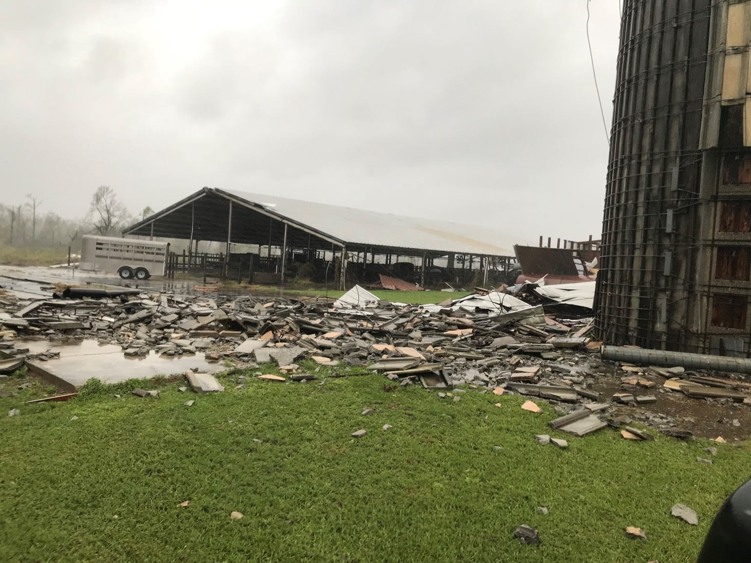
Post-Hurricane Photos
Notes:
This is what Crooked Creek Farms looked like after Hurricane Michael’s destruction.
The operation suffered structural damages, long-term animal health impacts, and 21 days of power outages.

Slide 12
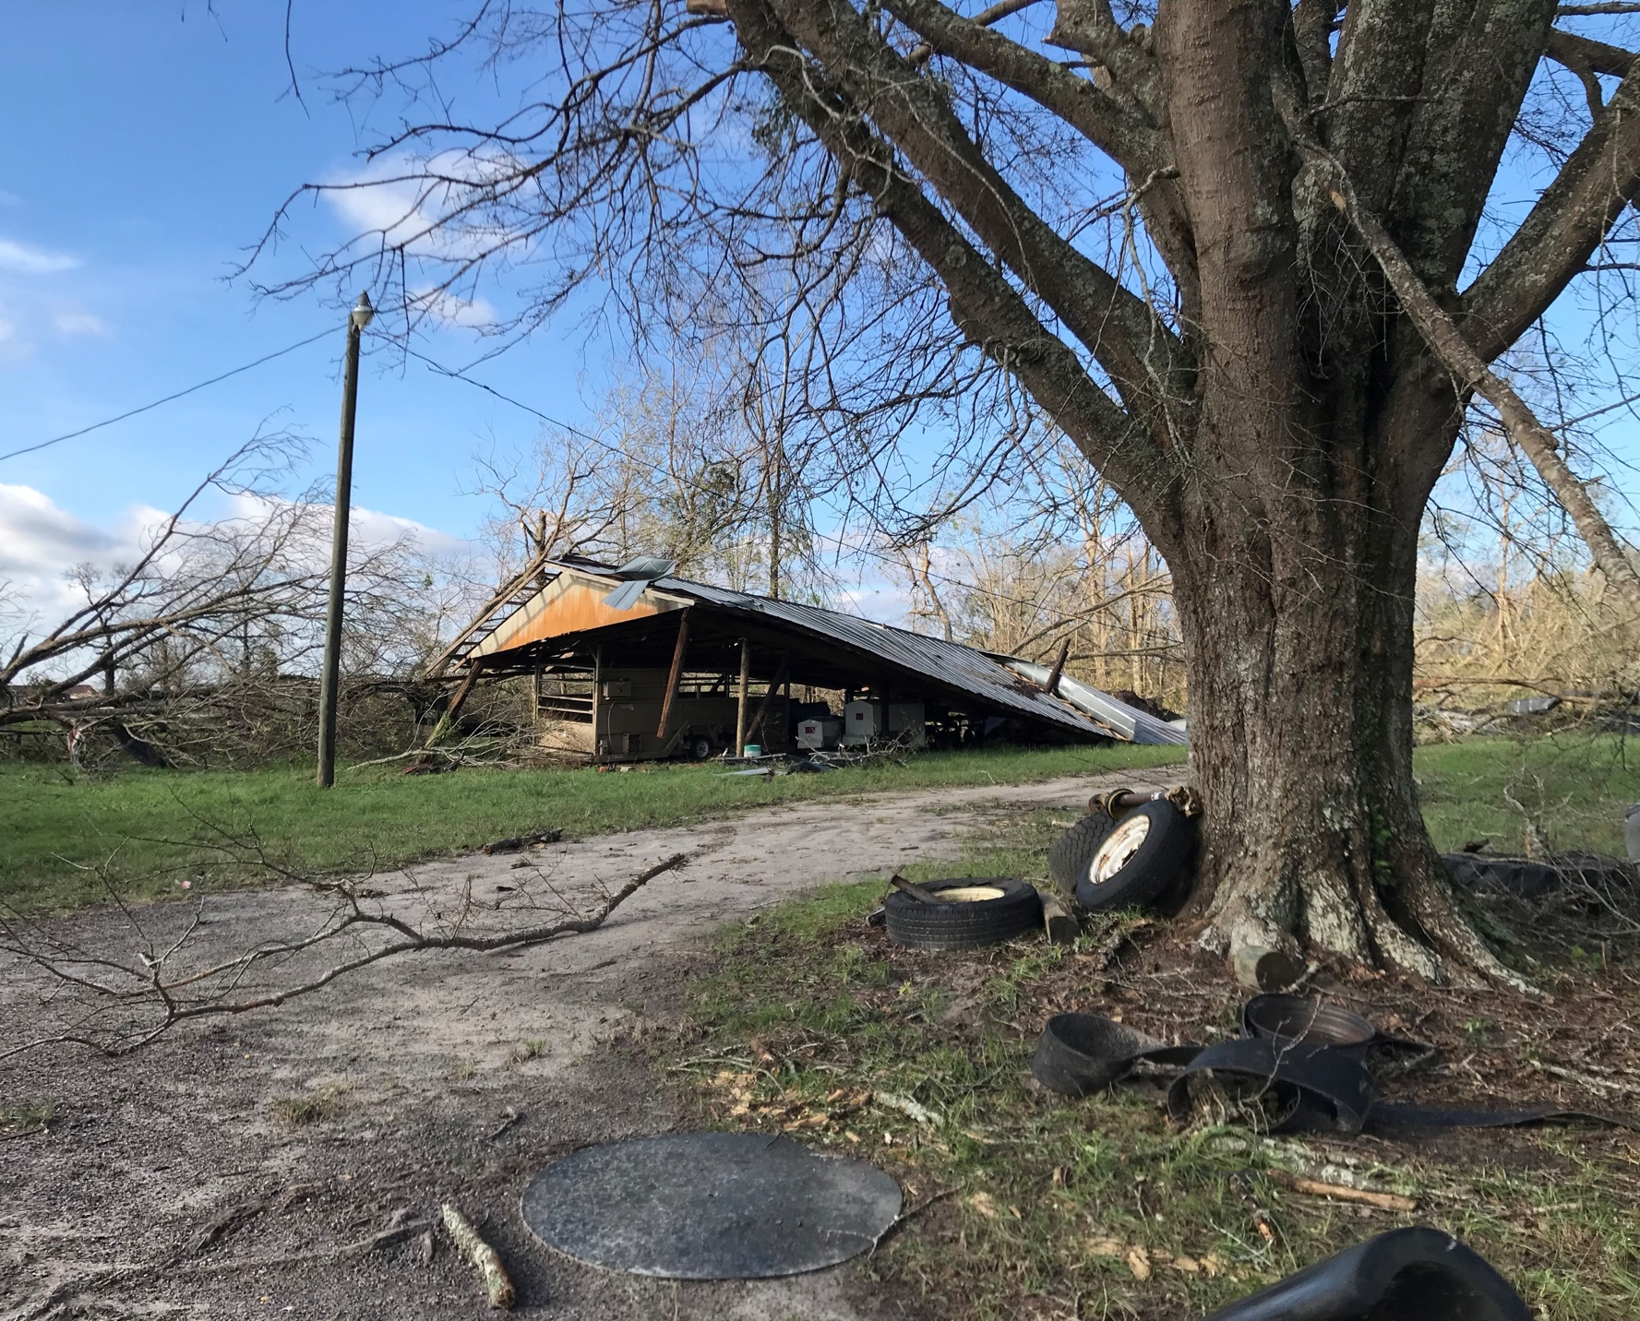
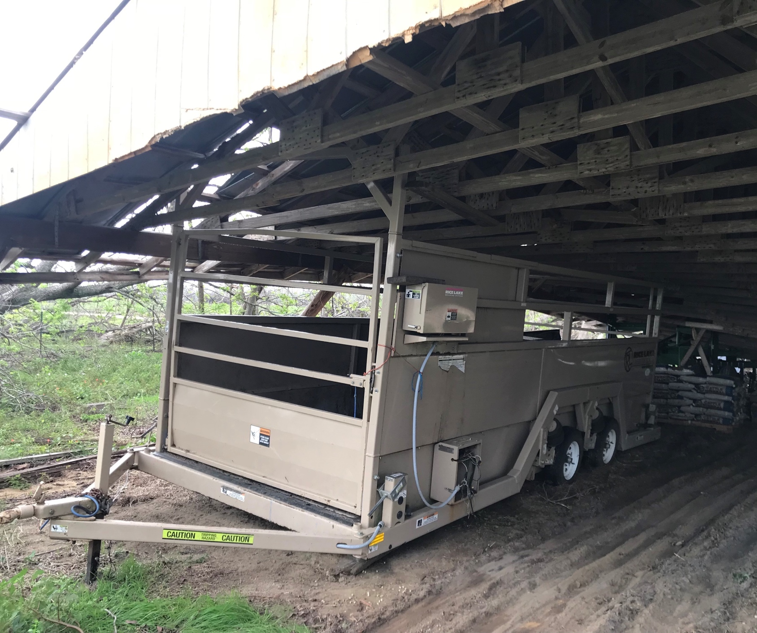
Post-Hurricane Photos
Notes:
Examples of structural and equipment damage
Beaver had to wait for neighbors to come with their tractor to lift building debris off his tractor, so he could start unburying the rest of his equipment and removing fallen trees from fences.

Slide 13
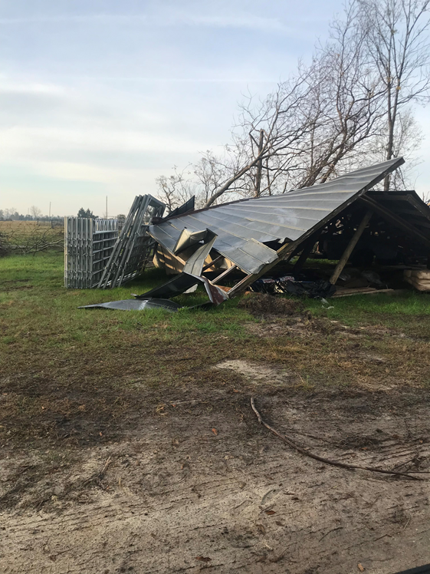
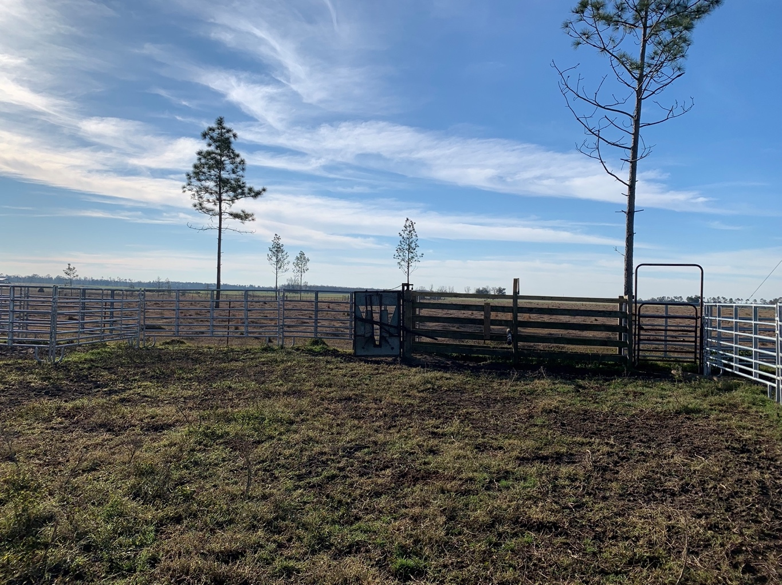
Post-Hurricane Photos
Notes:
Examples of property and animal handling equipment damage
Trees down on the cattle handling chutes and management areas and sheds collapsed.

Slide 14
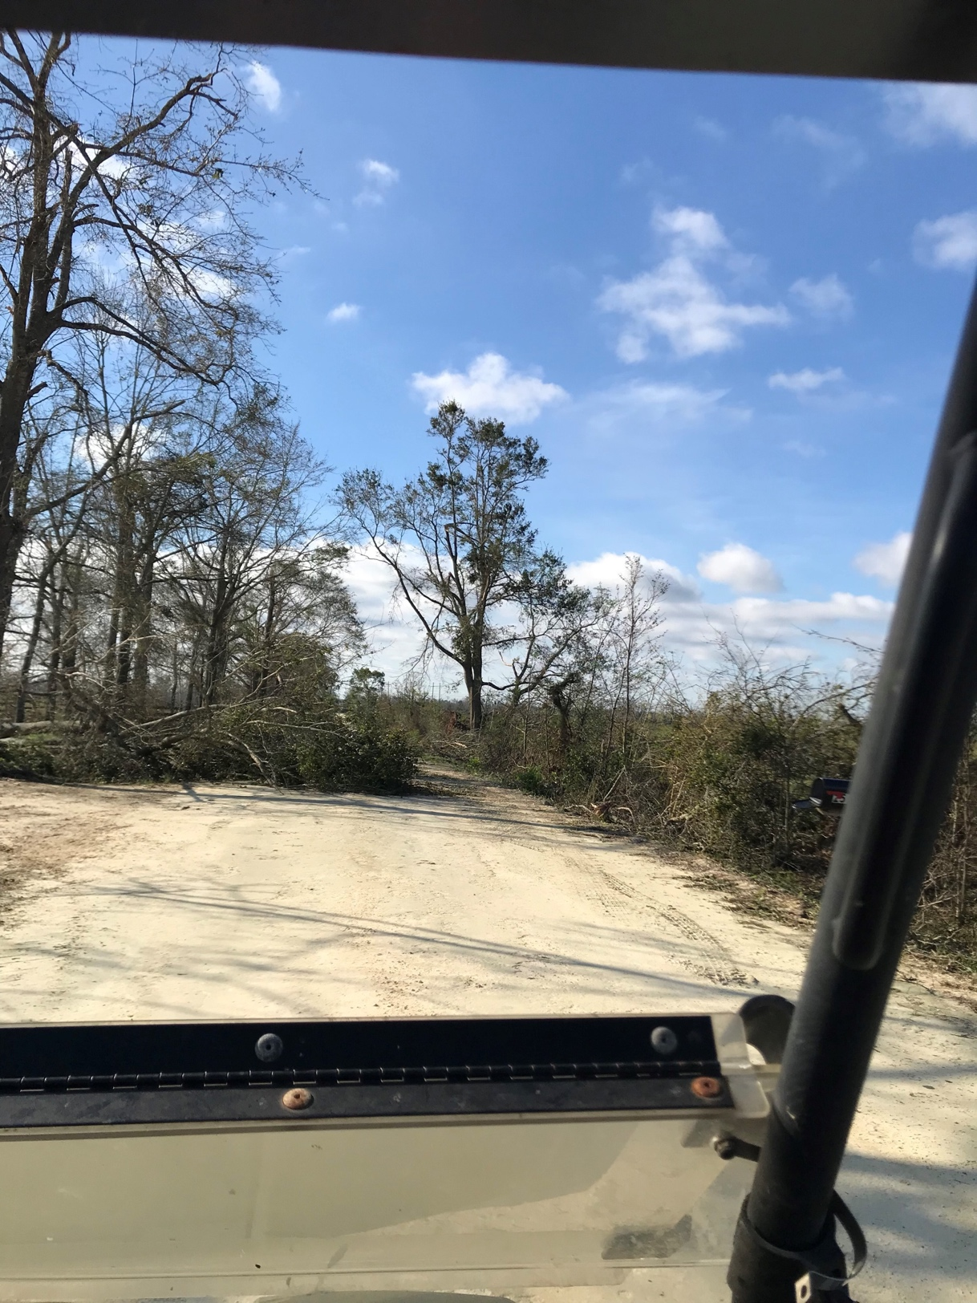
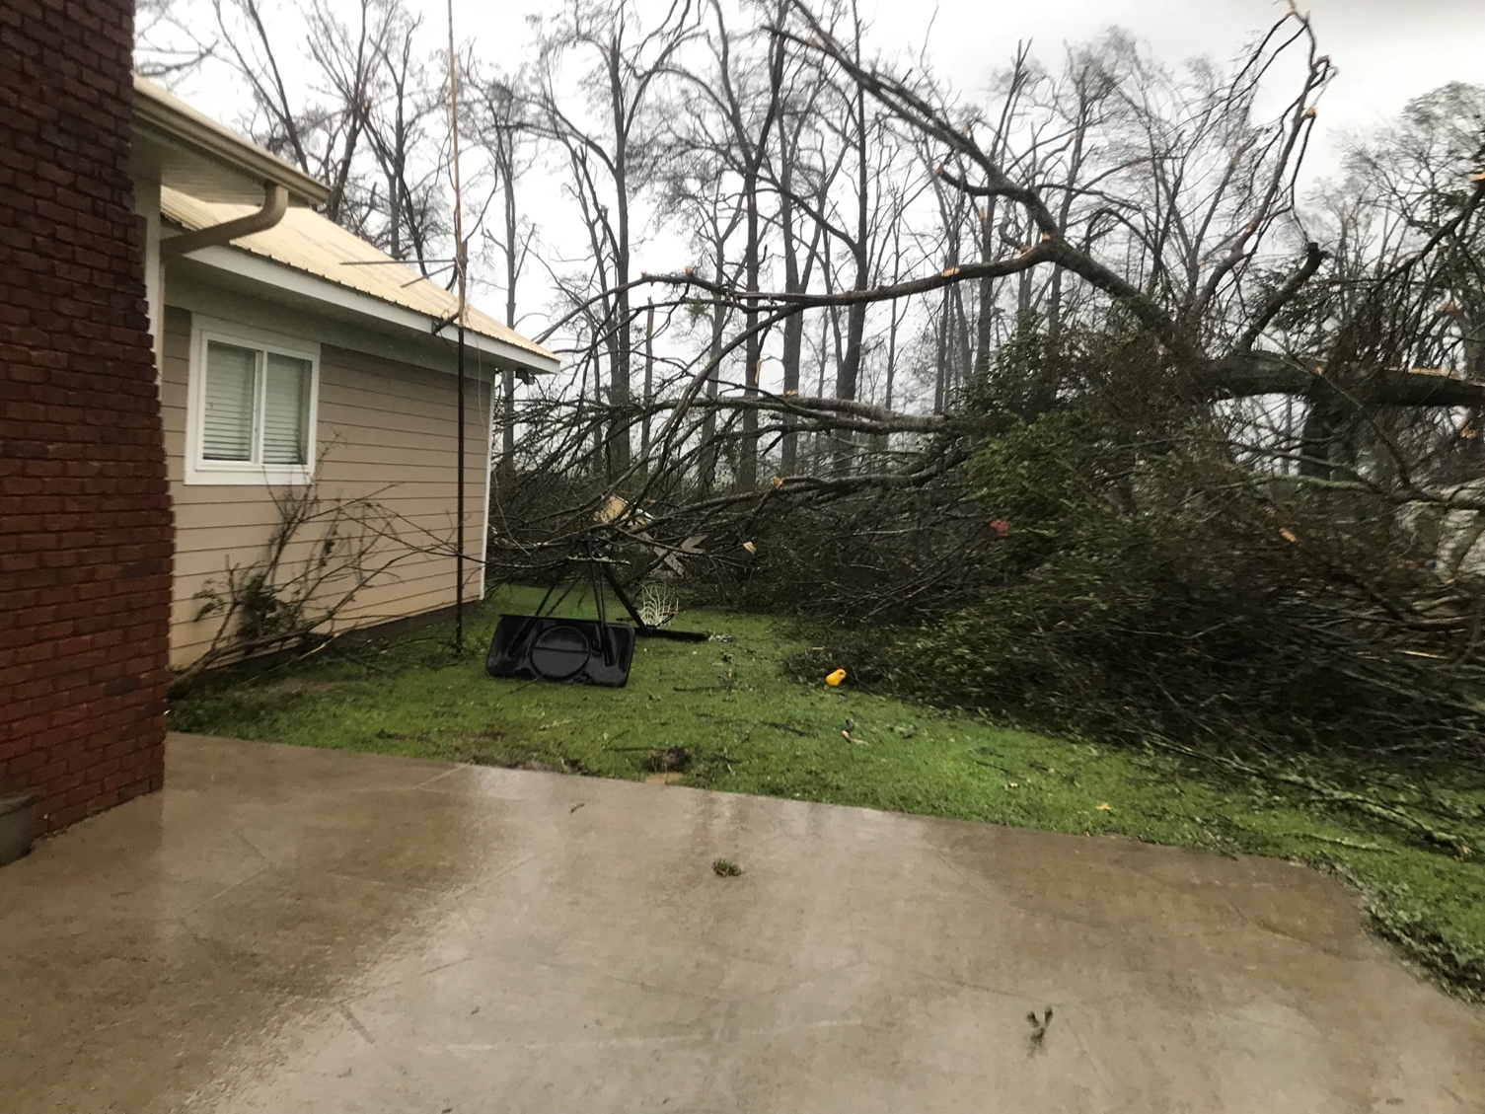
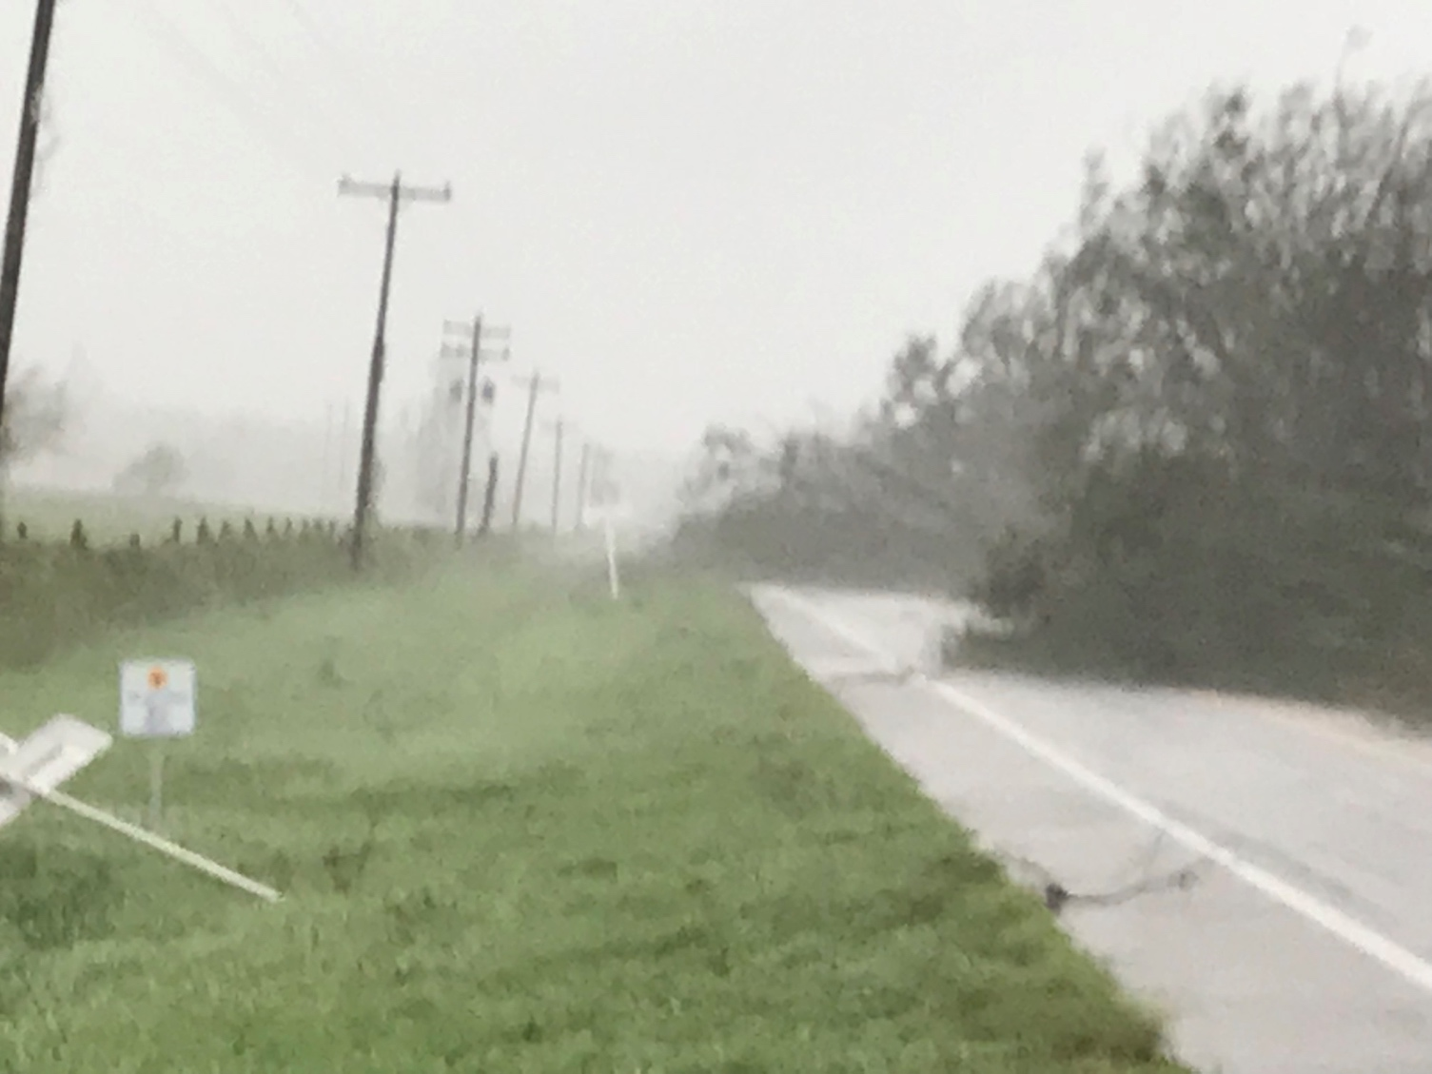
Post-Hurricane Photos
Notes:
Examples of property damage and massive downed trees made travel difficult.

Slide 15
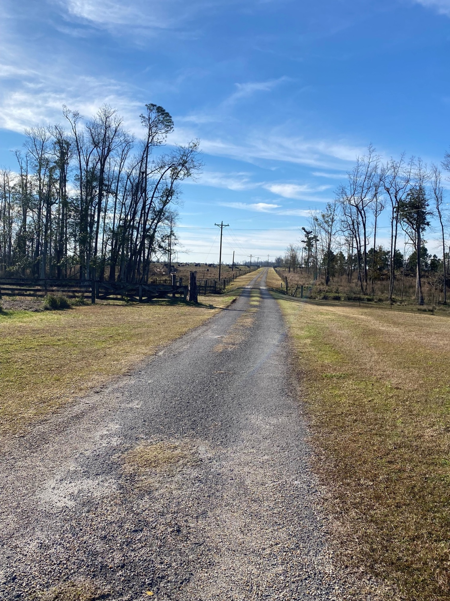
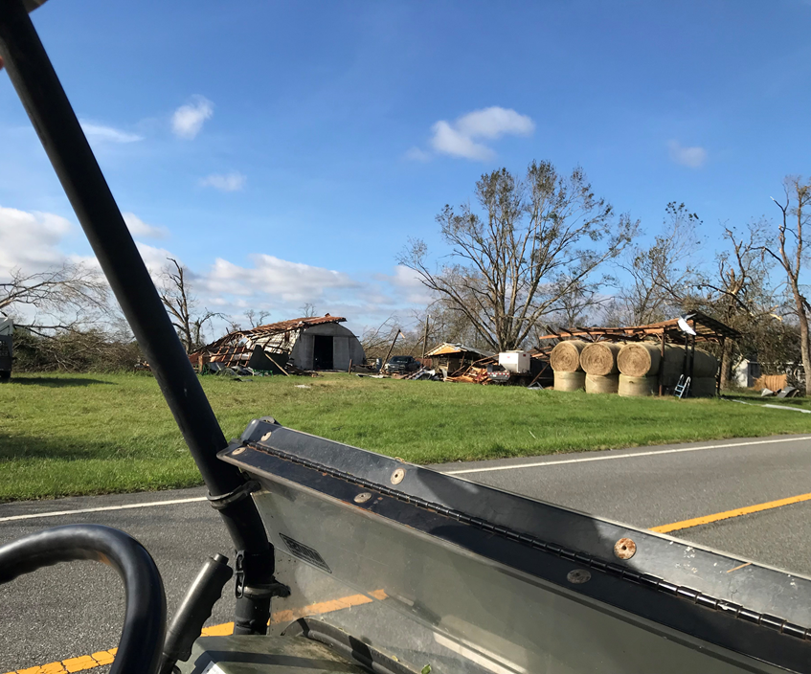
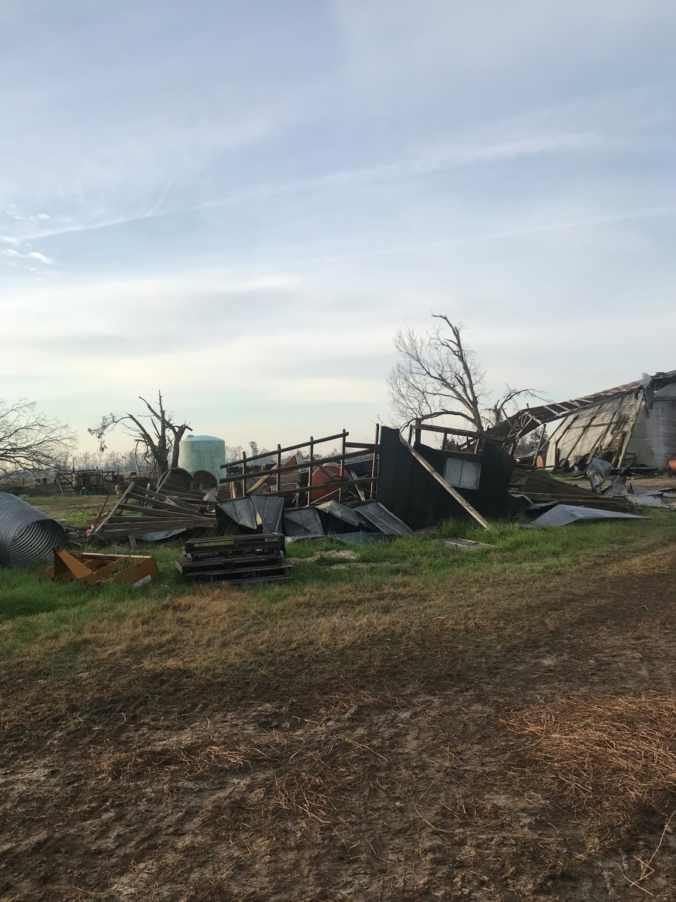
Post-Hurricane Photos
Notes:
Examples of property damage with collapsed buildings and damaged fencing.

Slide 16
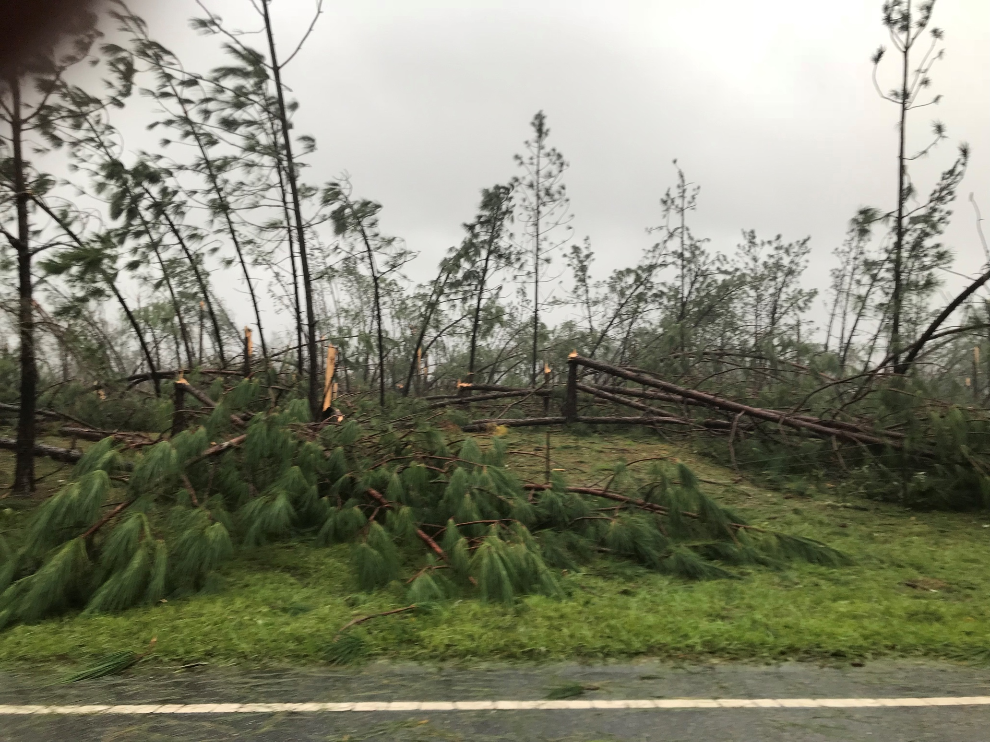
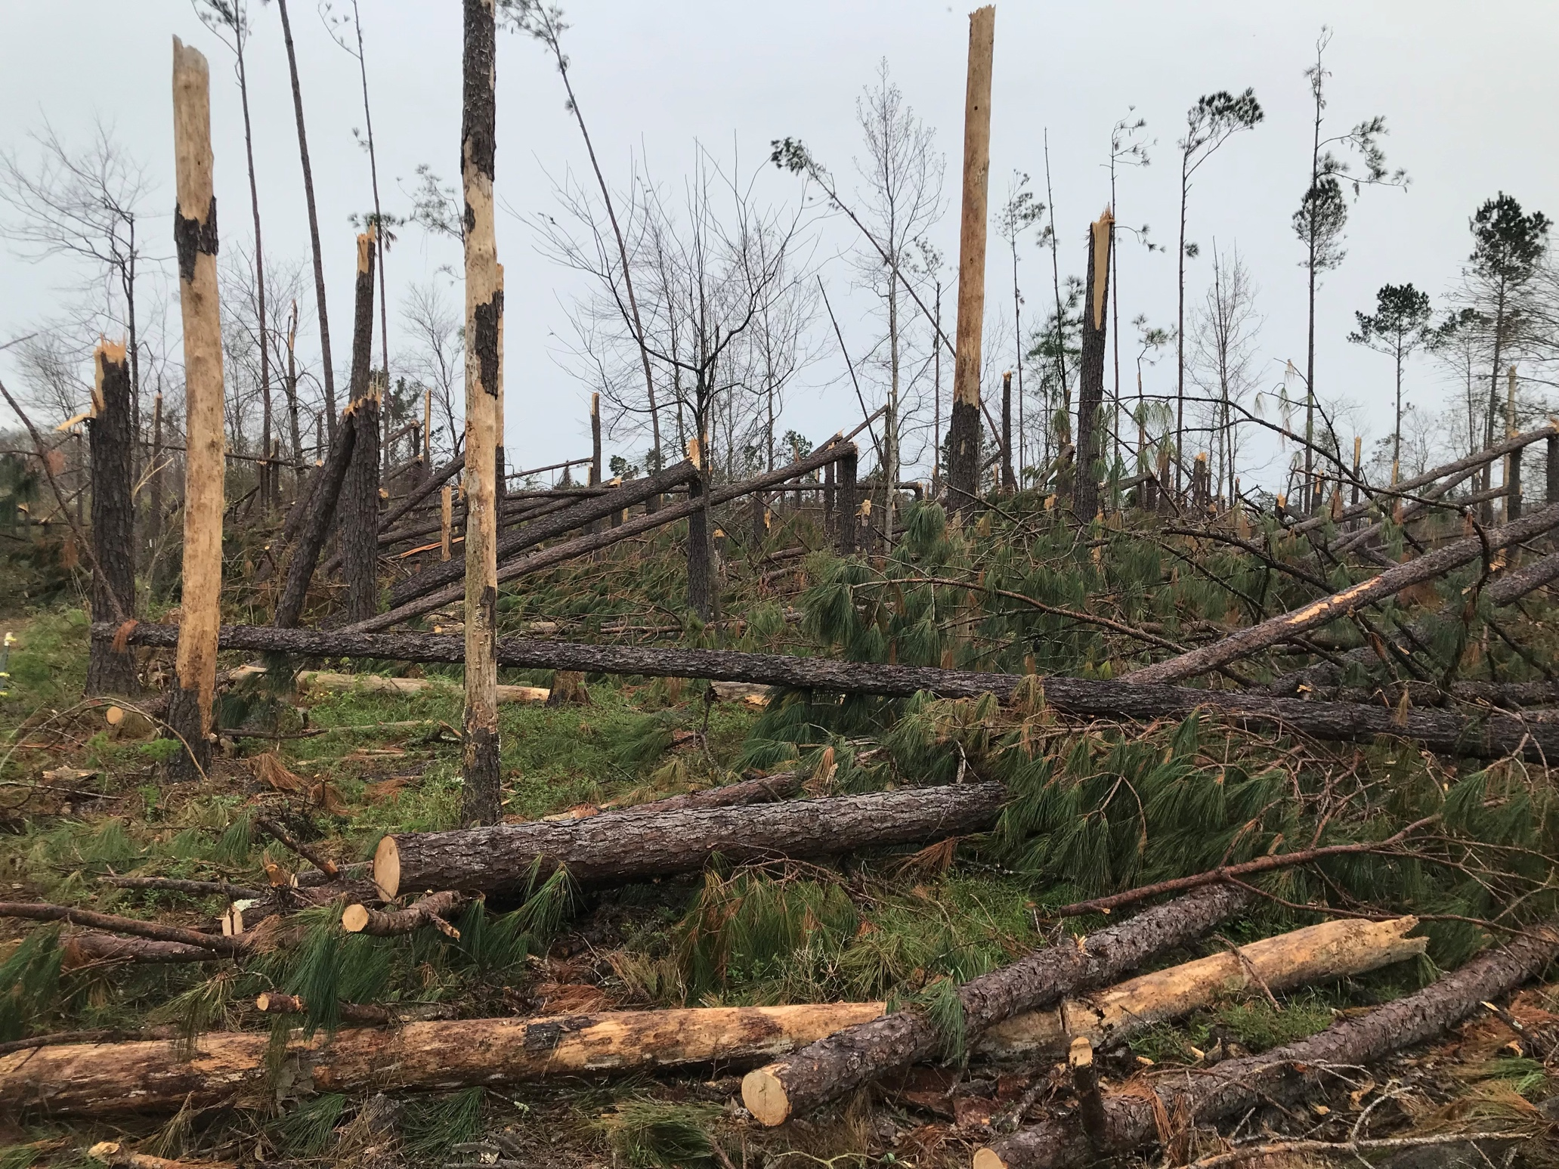
Post-Hurricane Photos
Notes:
Examples of timber damage

Slide 17
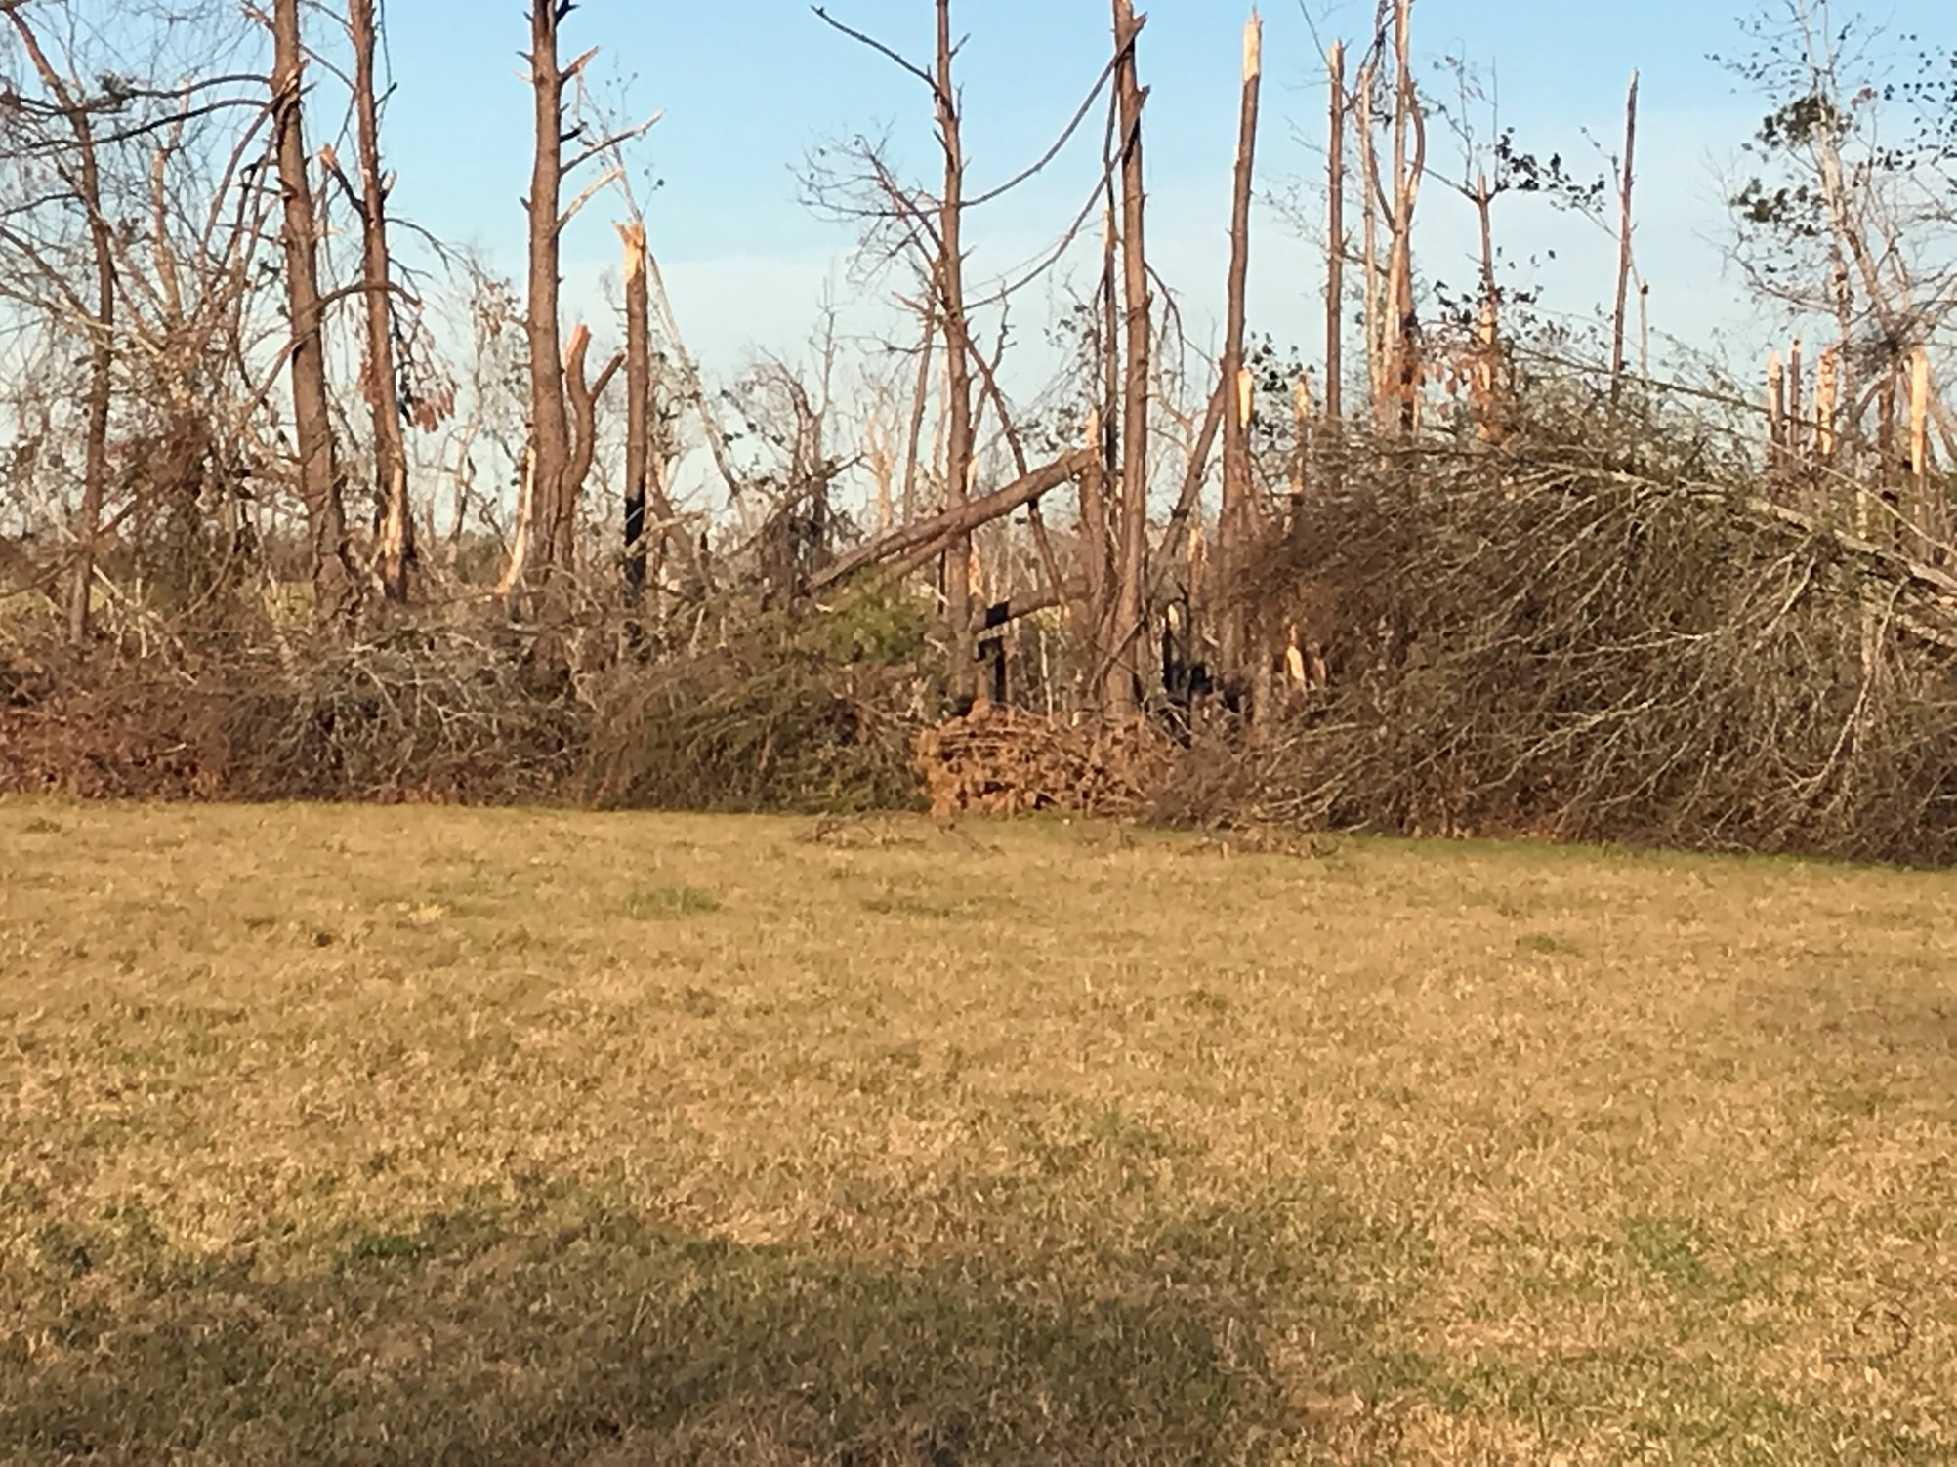
Post-Hurricane Photos
Notes:
Examples of timber damage

Slide 18
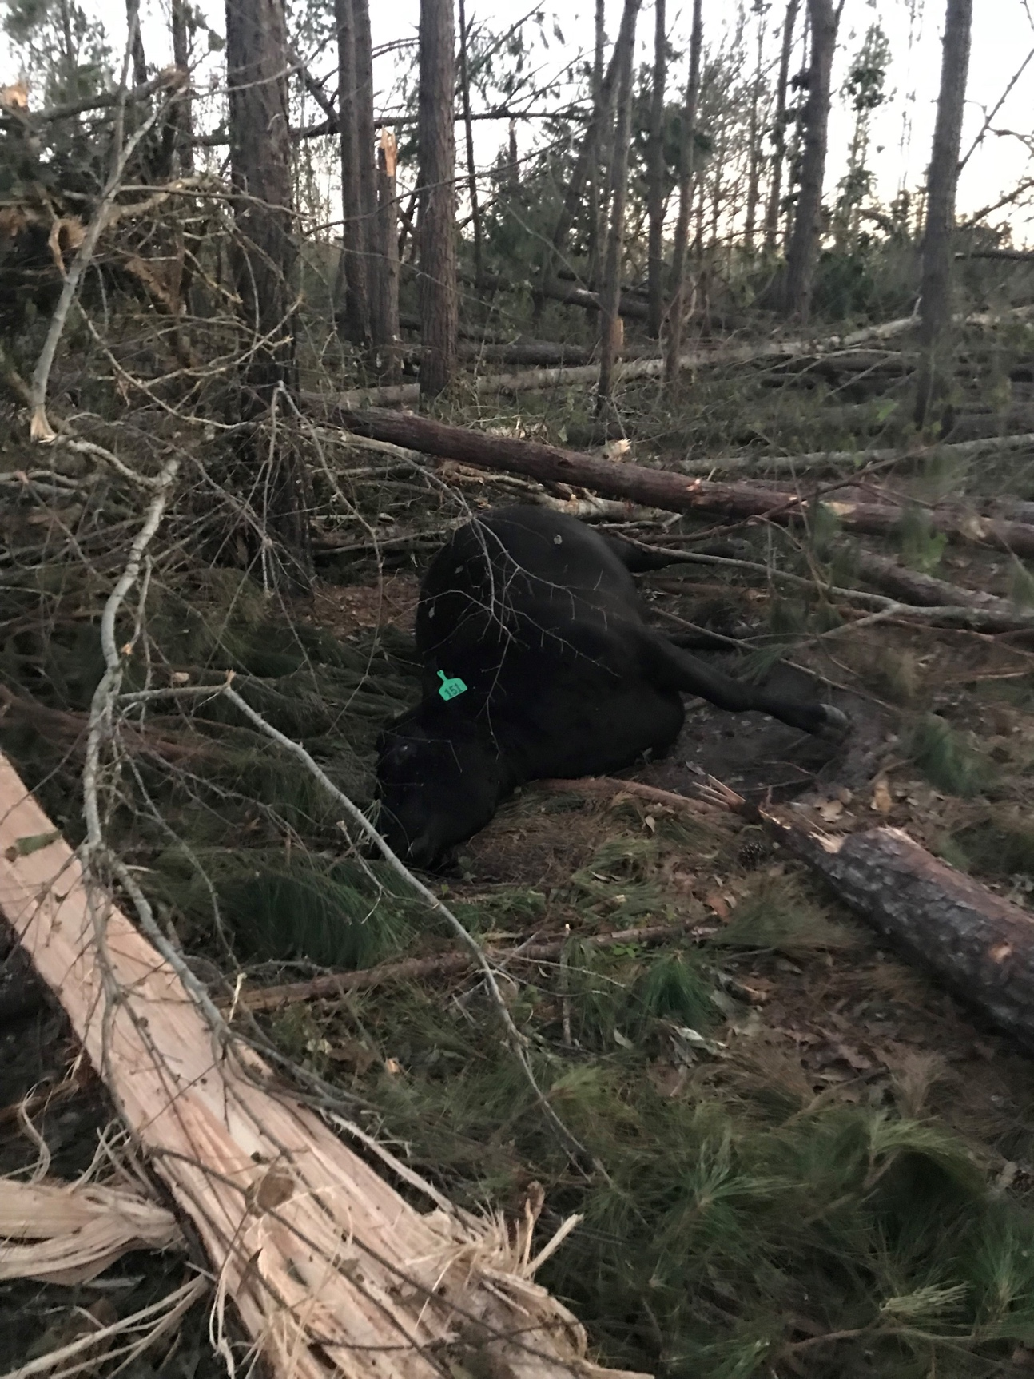
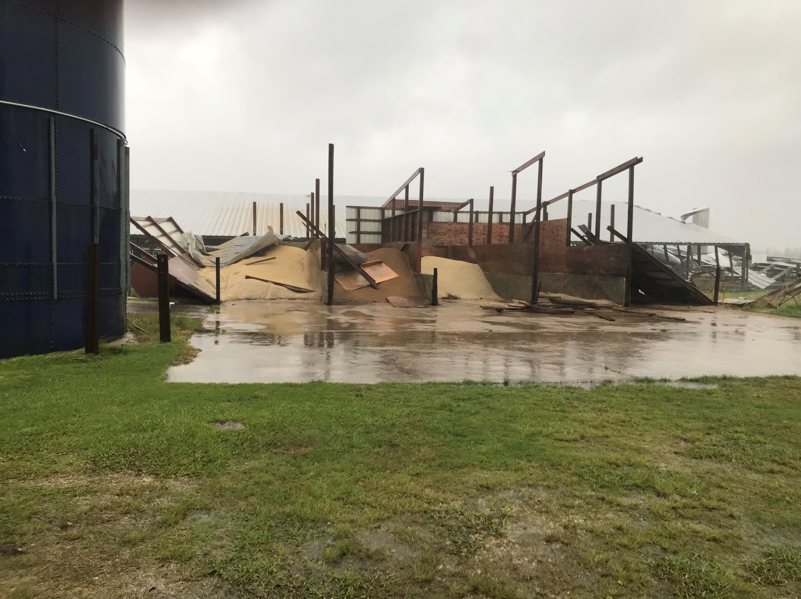
Post-Hurricane Photos
Notes:
Examples of livestock loss, long-term animal health issues, and feed/commodity loss.
There was not much rain that accompanied the actual hurricane; however, a lot of rain came after the hurricane, further deteriorating the quality of hay and feed available after the storm and into the next crop season.

Slide 19
Situation
Chose to stay and not evacuate
No guarantee he would have been able to get back to the farm
Had cattle to feed and water regardless of damage
Relocated 800 head to farm in Alabama
Fences, pastures, cattle management areas needed repair
Financial setbacks, governmental miscommunications or the lack of communication
Required strong dependance upon community support and helping each other
Notes:
Beaver Yoder and his family stayed at the farm because he knew he would have animal care responsibilities to attend to as soon as the storm passed. He knew he would not have been able to leave the area and return immediately, as there was no guarantee he would make it back to his farm immediately after the storm passed due to the damage and debris from the hurricane.
Beaver decided to move 800 head to Alabama to ensure adequate feed and water availability. By moving the cattle to Alabama, Beaver was able to focus more on what he needed to do - get fences and pastures repaired and get water.
It has been and will continue to be a long road to recovery for this town, especially dealing with setbacks and miscommunications, or lack of communication, between government officials and FEMA to the residents.
Livestock groups and associations were able to provide supplies before government organizations could. The local community members worked together to clear the roads and gather up the stray livestock.

Slide 20
Long-term & Short-term Focus
Re-thinking operation management plan, equipment, fence & animal handling designs
Electricity sources
Fencing/pasture layout & supply availability
Surface water availability
“Minimize your risk, minimize your risk, minimize your risk” (B. Yoder).
Notes:
Beaver is considering future management plans and recommends electricity sources, fencing and pasture layouts, and surface water availability as priority areas for others to focus on.
Unfortunately, most of his fencing had been designed to border tree lines to provide shade for the cattle; this ultimately became an issue as old, massive live oak trees toppled onto his fence.
Electricity was a major issue as powerlines were down or destroyed, transformers were laying in the middle of the roads, and generators were damaged from falling debris or were not available at all. If generators were available, they were already claimed for household support to preserve food and provide water; many farmers and ranchers were rotating their generators from the house to the pastures. Some even shared with their neighbors.
Yoder is looking to switch all his electric fences over to solar-powered units, so electricity still gets to the fences even when the main power goes down. He is advocating for Natural Resources Conservation Service (NRCS) to research the availability and reliability of solar well pumps, eliminating the need for generators to pump the water for the cattle.
Beaver has plans to re-design his fencing layout to be more mindful of water access and the proximity of trees to the fence lines and have extra gates or corral panels on hand to create holding pens if needed.
“Minimize your risk” (B. Yoder, personal communication, September 16, 2021).

Slide 21
Leadership Challenges
Fast thinking and quality decision-making required
Most stressful moment of many people’s lives
Long-term and short-term impact of those decisions
Maintaining order and command
Implementing lived experiences
Notes:
Leadership and communication skills are vital in making it through any disaster, especially one of this magnitude. There has to be order, command, quality decision-making abilities, ability to perform under pressure, and experience within those leaders.
There were numerous occasions where choices needed to be made on the fly and under some of the most stressful moments in many people’s lives. In times such as this, leadership abilities are put to a true test, and decisions that need to be made quickly also need to consider their impacts in the future.

Slide 22
Leadership Frames
Bolman and Deal (2013) Leadership Frames
Symbolic
Political
Human Resources
Structural
Notes:
Within this case study, you will be provided with foundational groundwork to analyze the decisions made and their correlation to leadership abilities. One way to analyze a given leadership situation is through Bolman and Deal’s (2013) four leadership frames.
The symbolic frame focuses on the organization's culture, and it includes things like the history, vision, and mission of the organization.
The political frame focuses on the relationships within the organization and connections between the organization and other organizations/institutions. It considers how information is exchanged, and networks are built.
The human resources frame focuses on the individuals in the organization. It considers if people are working in the best positions and have the necessary knowledge and skills to accomplish what they are being asked to do.
The structural frame focuses on the organizational structure. It considers if the current structure is best for the organization's environment. This includes the roles and responsibilities of individuals in the organization.

Slide 23
Symbolic Frame
Aftermath still visible today
Cleanup, rebuilding, demolition, abandoned
Lasting physical & emotional impacts
Difficult, life-altering decisions being made to fix or sell
Guilt, shame, failure, disappointment
Independent & self-sufficient people
Faith, family, friends, encouragement, willingness, resilience
“Even after the buildings are repaired/replaced/rebuilt the scars the trees bear will forever be a reminder of what happened. The youth pass by those scars everyday on their way to and from school, some were not even alive when Michael went through but see the damages and just don’t understand” (Yoder).
Notes:
The aftermath is visible three years later, still being cleaned up, rebuilt, demolished, and abandoned. The impacts of the storm were not only physical but emotional too. Farmers and ranchers were forced to make incredibly difficult decisions to give up their dreams and sell what they had because they could not get ahead enough to fix the damages from the hurricane.
There were feelings of guilt, shame, failure, and disappointment because some could not continue their family’s legacy of farming or ranching. Beaver’s beliefs, values, and culture impacted his decisions as a farmer/rancher/business owner.
Farmers and ranchers are naturally very independent and self-sufficient people. Having to rely on someone else for the help they needed to get back to ‘business as usual’ was most likely a difficult decision to work through for Beaver and other impacted farmers and ranchers.
He utilized his faith, family, and friends and their encouragement and willingness to help wherever they could to make it through this challenging event.

Slide 24
Political Frame
Frustrations with distribution and availability of emergency supplies and monetary aid
Cattlemen’s Association
Delivered pallets of bottled water before state or government could help
Farm Bureau
Out-of-state utility companies
Other agricultural groups
Truckloads of lick tanks and salt blocks
Mennonite groups providing cleanup services
“We can do better together than we can do apart” (B. Yoder).
Notes:
Some frustrations they experienced surrounded the distribution of emergency supplies and monetary aid before and following Michael’s landfall.
Independent groups, such as the Cattleman’s Association, Farm Bureau, and utility companies from other states, were able to connect with individuals to determine what needs were not being met. They looked for the areas where they could make the most impact.
The Cattleman’s Association was able to deliver pallets of water to the small town of Altha before the state or government could deliver resources due to road blockages and other travel and logistical complications.
Another group heard about the farmers’ and ranchers’ needs and had a truckload of mineral lick tanks and salt blocks delivered without being directly asked to help.
A group of Mennonites from Ohio spent a week helping with major cleanup by offering chainsaw work and use of other large machinery. They were able to lift building pieces off farmers’ machinery sheds. Some of this machinery was necessary for the cleanup inaccessible.
The agricultural industry is a small, tight-knit community, but their relationships prove critical for recovery and survival.

Slide 25
Human Resources Frame
Worked closely with local Extension agent
Coordination of supplies & people offering to help
People with and without animal handling skills volunteered
Strong community bond and relationships were key
Cleared some roadways themselves with tractors and skid-loaders
“It just takes grit” (B. Yoder).
Notes:
Beaver worked closely with their local extension agent, who helped them immensely by assisting with the coordination of building and fencing supplies. Other community members offered their time and labor to help those in need.
It was recognized that without strong communities, family, friends, relationships, friendships, and willing organizations to help people make it through situations like these, there would not be the ‘grit’ just to keep plugging along.
Morale would suffer severely if individuals started to feel like they had to combat the entire situation on their own without support from others. Beaver welcomed people who were already familiar with handling and moving cattle and knew what needed to be done without being told.
Friends and community members cleared six miles of I-10 with tractors and skid loaders so supplies could get through to places in need.
Post-Hurricane Michael, farmers and ranchers were experiencing a whole new group of weeds that they had never seen or managed before. Farmers and ranchers utilized Cooperative Extension specialists for their educational assistance.

Slide 26
Structural Frame
Farm was not destroyed, but had major damage
Techniques specific to grazing operations
Fencing, electricity, shade, water, feed sources
Damage done in all areas
Loose, wandering cattle
Generators needed to pump water
21 days without power
“The better an operation is before a disaster, the better they will be afterwards” (B. Yoder).
Notes:
Crooked Creek Farms is still in existence and was not completely wiped off the map like some others were; however, that does not mean they did not suffer damages.
As a grazing operation, fencing, shade, water, and feed sources are critical needs. Fences were damaged, and the electricity was out for the fencers; beef cattle were wandering down the sides of roads and out in other fields or croplands. Getting the fences and electricity back up was high on the priority list; water was the next immediate need to be addressed. Generators had to be hooked up to the well pumps to pump water to the various stock tanks.
Most families only had one, maybe two, or no generators. If they had them, they were already being used to provide electricity to homes. By the end of the 21 days of no electricity, their town had gathered 18 generators for people to utilize. Beaver and his team used eight generators to power the well pumps to get water for the cattle.

Slide 27
Discussion
What leadership challenges do you think Beaver Yoder experienced before, during, and after the hurricane?
Notes:
Discuss what leadership challenges do you think Beaver Yoder experienced before, during, and after the hurricane?

Slide 28
Homework
Determine what the day-to-day animal care responsibilities are for a grazing beef farm.
What supplies might be necessary for daily operation, care, and management?
Notes:
Determine what the day-to-day animal care responsibilities are for a grazing beef farm.
What supplies might be necessary for daily operation, care, and management?

Slide 29
The Solution
Notes:
Let’s help Crook Creek Farms and others better prepare for the next hurricane.

Slide 30
The Problem
Crooked Creek Farms would like your assistance to create an emergency preparedness/management plan.
You should consider the needs of the livestock and the individuals caring for them, along with their own families and homes.
Provide three recommended changes you would implement for the next natural disaster.
Notes:
Crooked Creek Farms would like your assistance in creating an emergency preparedness/management plan. You should consider the needs of the livestock and the individuals caring for them, along with their own families and homes.
Provide three recommended changes you would implement for the next natural disaster.

Slide 31
Your Assignment
Create a proposal for Beaver Yoder of Crooked Creek Farms by addressing the following questions:
Overall:
What are the requirements for successfully grazing beef cattle in the Florida Panhandle?
How would your proposal be different if this were an equine or dairy farm?
Animal care/feed/water
Containment/fencing/buildings
Electricity/generators (continued...)
Notes:
As a group, develop an emergency management and preparedness plan proposal for Beaver Yoder and Crooked Creek Farms.
Consider the following questions:
What are the requirements for successfully grazing beef cattle in the Florida Panhandle?
How would your proposal be different if this were an equine or dairy farm?
Animal care/feed/water
Containment/fencing/buildings
Electricity/generators

Slide 32
Your Assignment (cont.)
Consider the following questions to guide you through the process:
What would it be like operationally to manage a beef cattle farm during and after a natural disaster?
What leadership issues might surface related to the management of a beef cattle operation after being impacted by a natural disaster?
How were leadership skills beneficial to the rebuilding and recovery process? How could they have been better?
How could an emergency management plan be implemented in the event of another hurricane or natural disaster?
Identify examples of the resiliency of those within the agricultural industry whom a natural disaster has impacted.
Notes:
Consider the following questions to guide you through the process:
What would it be like operationally to manage a beef cattle farm during and after a natural disaster?
What leadership issues surface related to the management of a beef cattle operation after being impacted by a natural disaster?
How were leadership skills beneficial to the rebuilding and recovery process? How could they have been better?
How could an emergency management plan be implemented in the event of another hurricane or natural disaster?
Identify examples of the resiliency of those within the agricultural industry whom a natural disaster has impacted.

Slide 33
Your Assignment (cont.)
Consider these symbolic lens questions:
How is being a rancher symbolic?
How do you think Amish cultural values and views, such as pride and independence, impact his decision-making abilities and resilience?
Do you think Beaver values his family’s history with the farm?
How do you think Beaver’s relationship with everyone, not only close friends and family, impacted their response and recovery?
Notes:
Consider these symbolic lens questions:
How is being a rancher symbolic?
How do you think Amish cultural values and views, such as pride and independence, impact his decision-making abilities and resilience?
Do you think Beaver values his family’s history with the farm?
How do you think Beaver’s relationship with everyone, not only close friends and family, impacted their response and recovery?

Slide 34
Your Assignment (cont.)
Consider these political lens questions:
How did the state and department of agriculture help in the recovery?
Who had the power in this situation?
Who or what had the political power to make decisions?
What roles did FEMA and FSA play in the preparation and recovery/rebuild processes?
Notes:
Consider these political lens questions:
How did the state and department of agriculture help in the recovery?
Who had the power in this situation?
Who or what had the political power to make decisions?
What roles did FEMA and FSA play in the preparation and recovery/rebuild processes?

Slide 35
Your Assignment (cont.)
Consider these human resources lens questions:
Are there trainings that could have been beneficial for Crooked Creek Farms?
Utilized cooperative extension specialists for educational assistance
Post-Hurricane Michael, farmers and ranchers experienced a new group of weeds never seen or managed before
What other trainings do you think might be beneficial to Beaver and others in affected areas?
How do you think the inability to make decisions in the ‘heat of the moment’ impacted the experience?
Can you identify what resources were made available to Beaver prior to and post-event?
Notes:
Consider these human resources lens questions:
Are there trainings that could have been beneficial for Crooked Creek Farms?
Utilized cooperative extension specialists for educational assistance
Post-Hurricane Michael, farmers and ranchers experienced a new group of weeds never seen or managed before
What other training do you think might benefit Beaver and others in affected areas?
How do you think the inability to make decisions in the ‘heat of the moment’ impacted the experience?
Can you identify what resources were made available to Beaver before and post-event?

Slide 36
Your Assignment (cont.)
Consider these structural lens questions:
What were some communication channels utilized?
Were there channels missing or could they have been relayed differently?
What were some difficulties Beaver and others faced when working with policies for disaster aid?
Notes:
Consider these structural lens questions:
What were some communication channels utilized?
Were there channels missing, or could they have been relayed differently?
What were some difficulties that Beaver and others faced when working with policies for disaster aid?

Slide 37
Your Assignment (cont.)
Leadership & Management
What technical trainings could Beaver Yoder seek that would compliment and improve his leadership abilities?
How might the ways in which Beaver operates his business assist other farmers/ranchers in the area?
Notes:
Leadership & Management
What technical training could Beaver Yoder seek to complement and improve his leadership abilities?
How might the ways in which Beaver operates his business assist other farmers/ranchers in the area?

Slide 38
Submission Criteria
Background Information – 30 points
Leadership Considerations – 30 points
Actionable Steps – 30 points
Professionalism – 10 points
See the rubric for more specific criteria.
Notes:
As a group, you will submit a single report.
Prepare this report as if you are sending it directly to Beaver Yoder, the owner/operator of Crooked Creek Farms.
You will be assessed on the following items:
- For the background information, describe Crooked Creek Farms, contractual grazing in the Florida Panhandle.
- For leadership considerations, describe the potential issues you foresee related to the organizational structure, human resources, symbolism, and relationships/politics.
- Next, describe actionable steps you see related to the contractual grazing arrangements with row croppers and the changes that could be implemented with the emergency management and preparedness plan. Be creative with your thinking and consider other issues that we have not already discussed.
-Finally, the professional appearance of your report will be assessed, so be sure to make it look official and check for any spelling or grammar errors.

Slide 39
References
Bolman, L. G., & Deal, T. E. (2013). Reframing organizations: Artistry, choice, and leadership. John Wiley & Sons.
Calhoun County Board of County Commissioners. (2020, September). Calhoun county long-term recovery plan [draft]. https://calhouncountygov.com/uploads/2020/09/draft-calhoun-county-long-term-recovery-plan.pdf
National Hurricane Center and Central Pacific Hurricane Center (NHC). (2018, October 10). Hurricane Michael intermediate advisory number 16A. https://www.nhc.noaa.gov/archive/2018/al14/al142018.public_a.016.shtml?
National Oceanic and Atmospheric Association (NOAA). (2019, April 19). Hurricane Michael upgraded to a category 5 at time of U.S. landfall: Post-storm analysis estimates sustained winds of 160 mph. https://www.noaa.gov/media-release/hurricane-michael-upgraded-to-category-5-at-time-of-us-landfall
U.S. Climate Data. (2018). Climate Panama City. https://www.usclimatedata.com/climate/panama-city/florida/united-states/usfl0392
World Population Review. (2021). Altha, Florida Population 2021. https://worldpopulationreview.com/us-cities/altha-fl-population

Slide 40
Preparing Organizational Leaders in Agriculture through Innovative Leadership Case Studies Contextualized in Agricultural Disasters
This material was created with funding from:
USDA/NIFA Higher Education Challenge Grant
Project # 2019-70003-29092
University of Florida, Auburn University, Texas A&M University, The University of Tennessee
Contact:
Dr. Grady Roberts
Professor
Agricultural Education and Communication
University of Florida
PO Box 112060
Gainesville, FL 32611-2060
groberts@ufl.edu
globaleducationlab.org
Notes:
Suggested Citation
Young, H., & Bunch, J. C. . (2022). Crooked Creek Farms and Hurricane Michael. Global Education Lab. https://www.globaleducationlab.org/portfolio/young
This material is based upon work that is supported by the National Institute of Food and Agriculture, U.S. Department of Agriculture, under award number 2019-70003-29092. Any opinions, findings, conclusions, or recommendations expressed in this publication are those of the author(s) and do not necessarily reflect the view of the U.S. Department of Agriculture.

